Slide 1
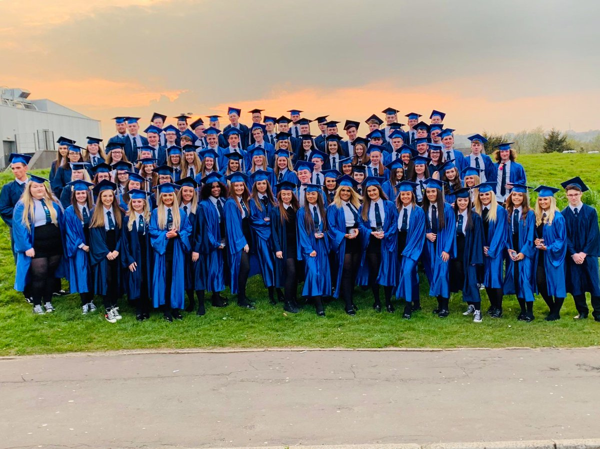
Associated Primary Schools
October 2020 Information Evenings

Slide 2
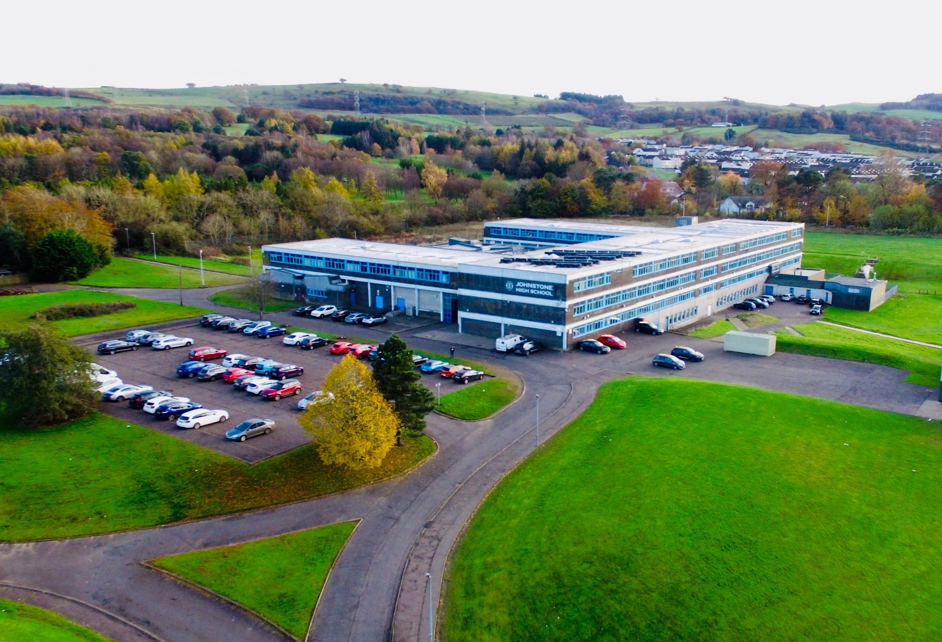
Welcome to Johnstone High School

Slide 3
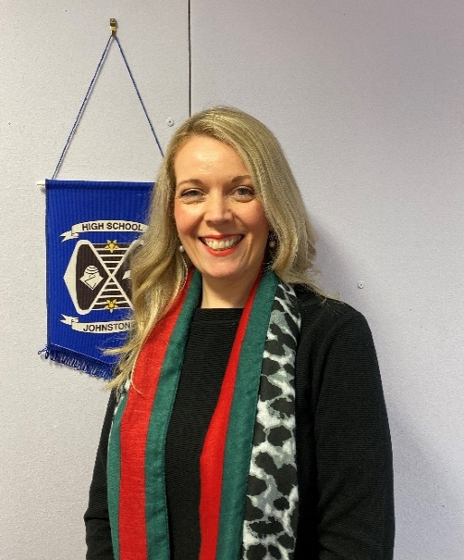
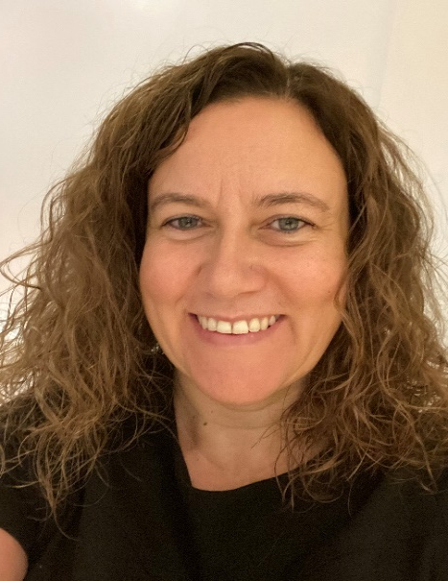
The team for the P7 roadshow
Mrs Hollywood
Head Teacher
Mrs O’Malley
Depute Head Teacher

Slide 4
Johnstone High School currently has a roll of 971 pupils. Pupils come to us from our 7 associated primary schools as well as primary schools out with our catchment area. In the next few slides we will introduce you to our senior management and pastoral support staff in their house teams.

Slide 5
We have 4 house groups at Johnstone High School. Each house group has a Principal Teacher of Pastoral Support and a Depute Head Teacher who look after the pupils in their house. The 4 houses are called Arran, Iona, Mull and Skye.

Slide 6
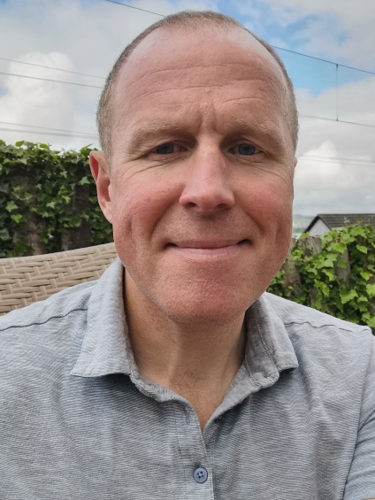
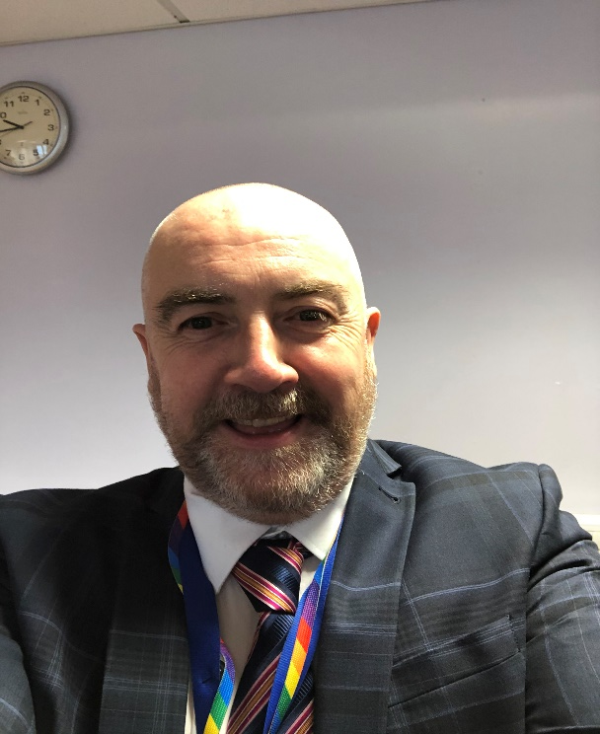
ARRAN HOUSE
Mr Rainey
Principal Teacher of Pastoral Care
Mr Munro
Depute Head Teacher

Slide 7
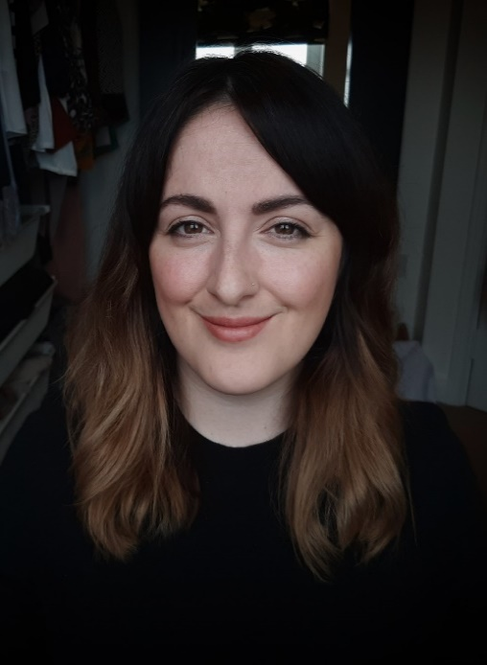
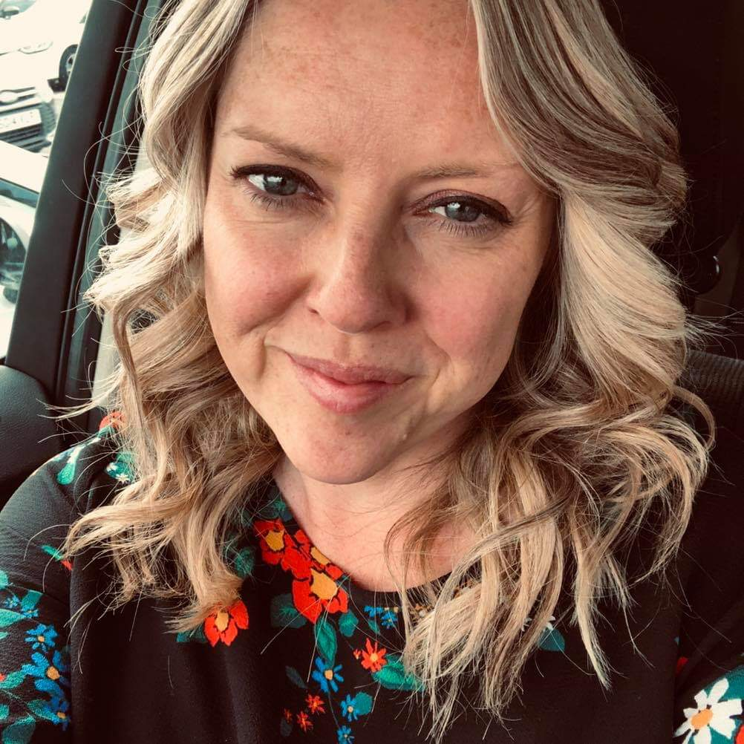
IONA HOUSE
Mrs Butler-Robson
Principal Teacher of Pastoral Care
Mrs Cole
Depute Head Teacher

Slide 8
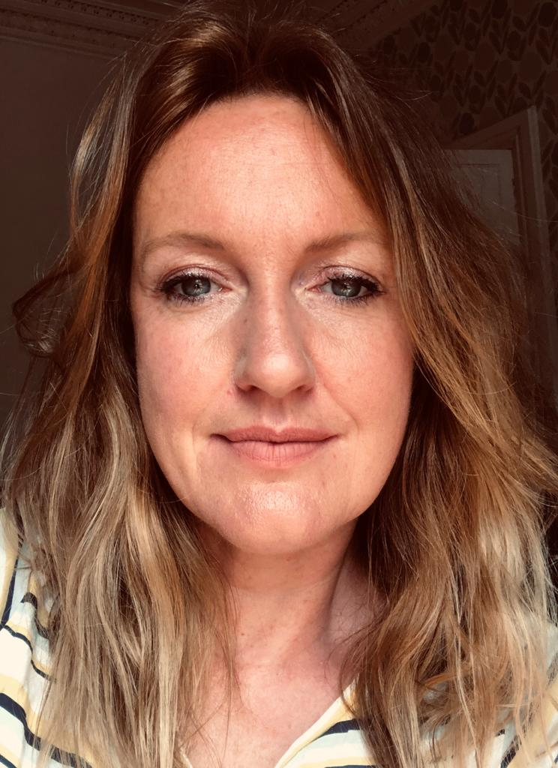
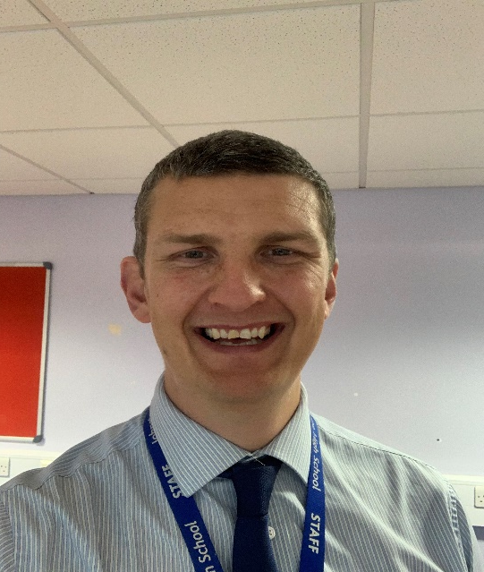
MULL HOUSE
Mrs Wilson
Principal Teacher of Pastoral Care
Mr Menzies
Depute Head Teacher

Slide 9
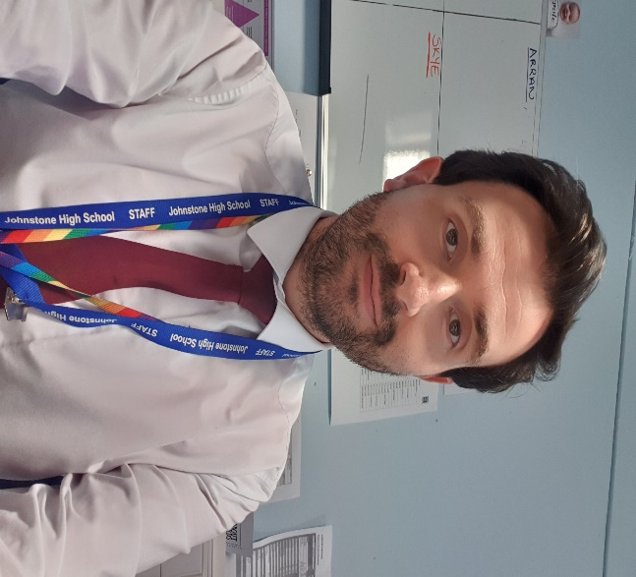
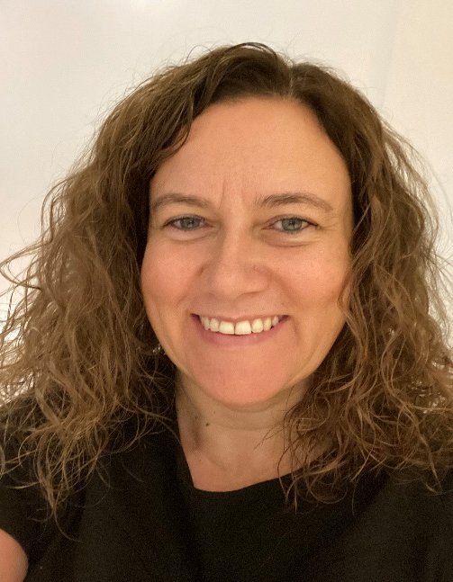
SKYE HOUSE
Mr Kennedy
Principal Teacher of Pastoral Care
Mrs O’Malley
Depute Head Teacher

Slide 10
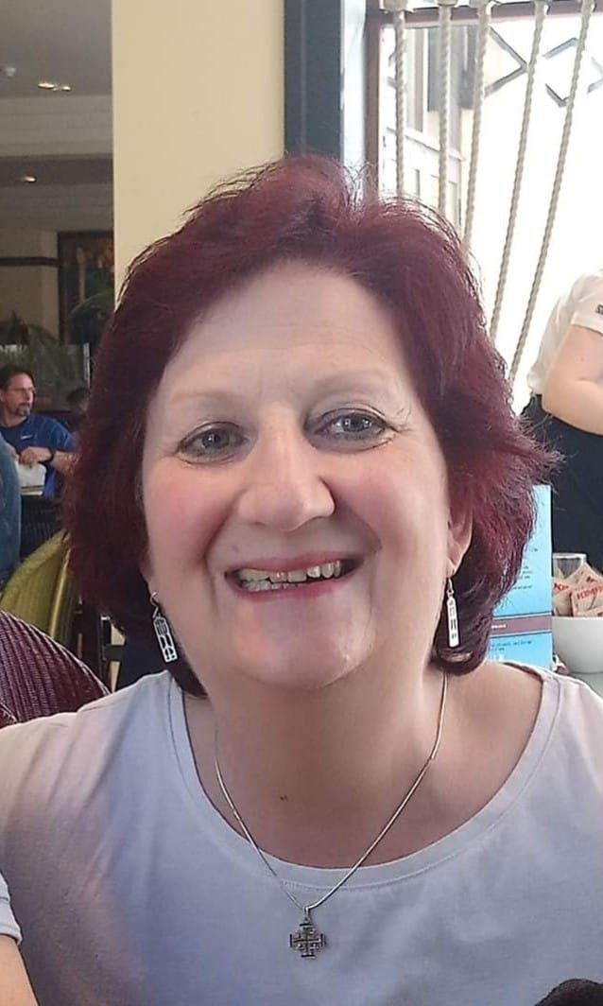
S6 Pupils
Arran, Iona, Mull and Skye
Miss Wilkie
Principal Teacher of Pastoral Care

Slide 11
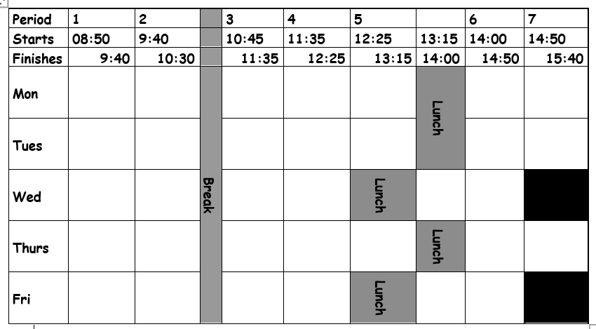
The school Day

Slide 12
What subjects will you study?
In S1-S3 you will be following a Broad General Education (BGE) course
You will study Maths, English, Modern Languages, Social Subjects, Science, Art, Music, PE, Home Economics(H.E.), Computing & Business Education, Technical, Religious and Moral Education(RME), Personal and Social Education(PSE).

Slide 13
Senior Phase (S3-S6)
You will get to make more specialist subject choices and work towards national qualifications
We offer a variety of subjects including psychology, health care, travel and tourism, sport and recreation, college courses and foundation apprenticeships

Slide 14
An example of an S1 pupil’s timetable

Slide 15
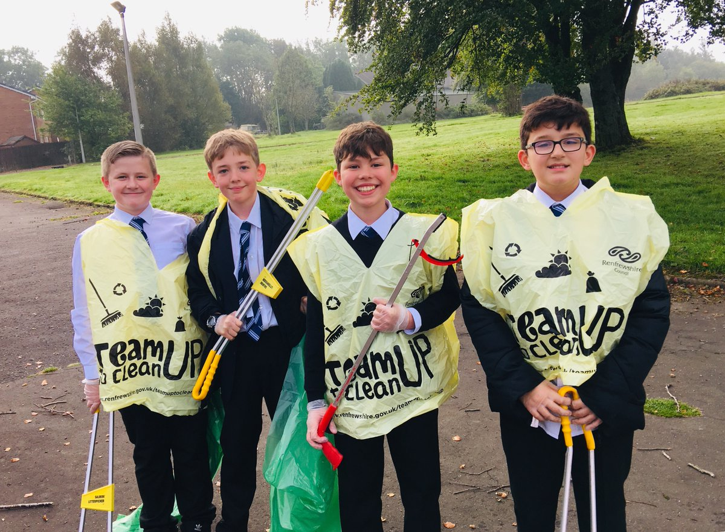
What will happen when you go to high school?
3 day visit in June 2021 (9th, 10th & 11th June)
Classes
Befrienders (S6 pupils)
Pastoral staff
Teachers
Pupils

Slide 16
Supports for pupils
House Teams
Teaching staff
Extended support team (EST)
Support for Learning
Nurture
Home link
Counselling
Inclusion Support Assistant
Parents in Partnership
Employability
Skills Development Scotland

Slide 17
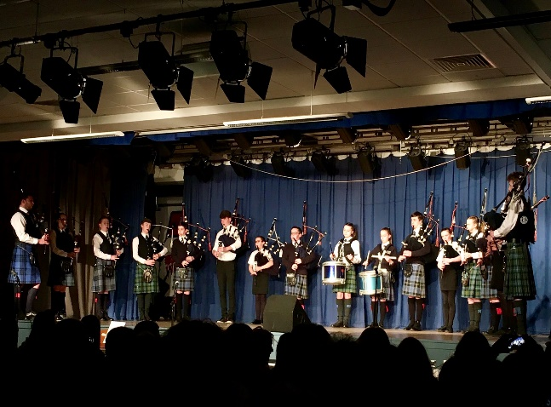
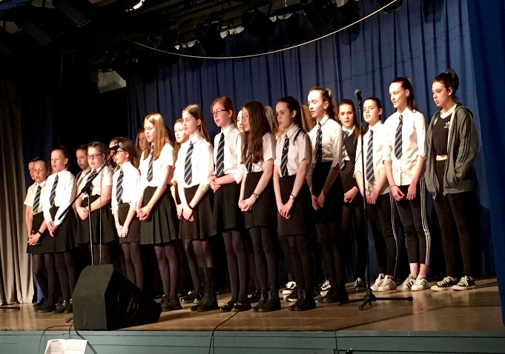
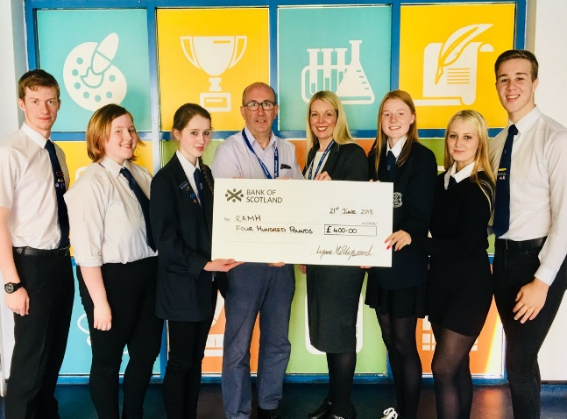
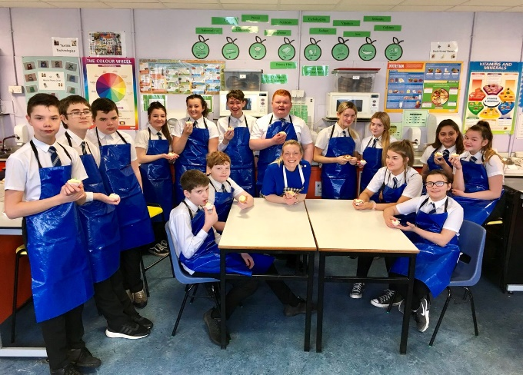
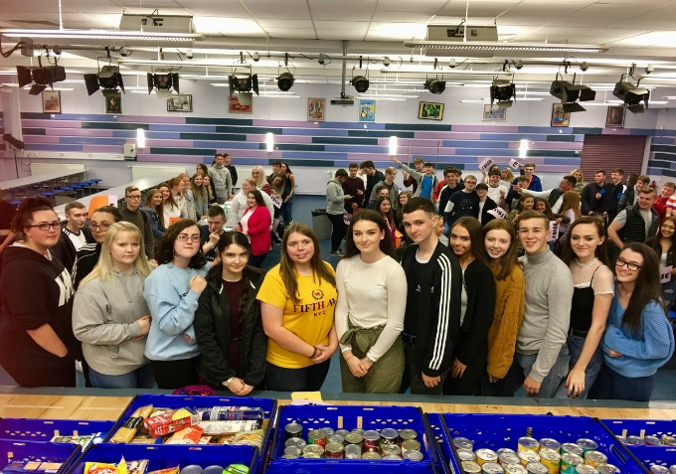
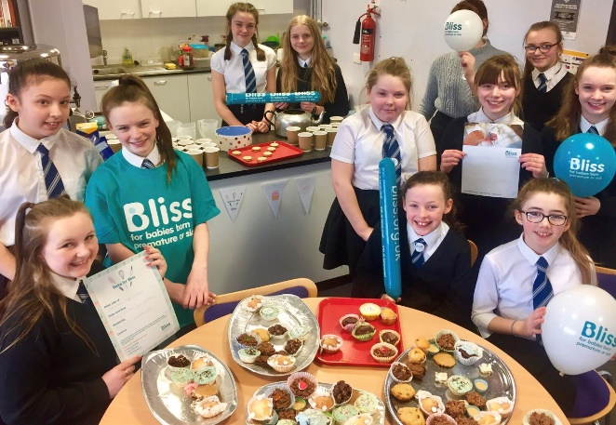
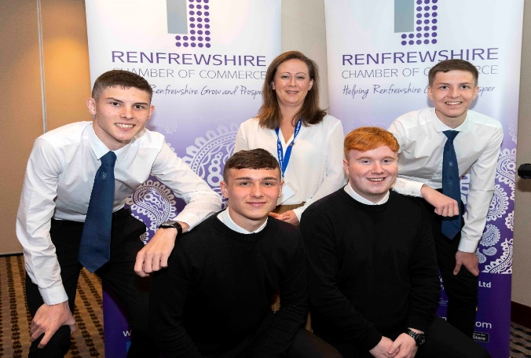
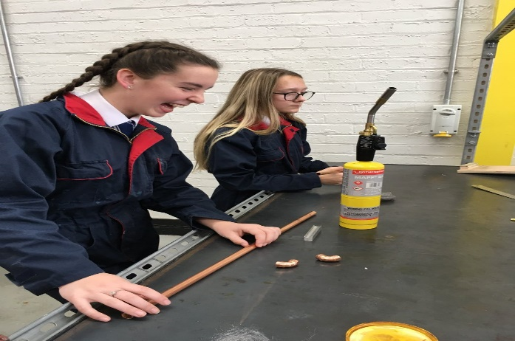
OPPORTUNITIES

Slide 18
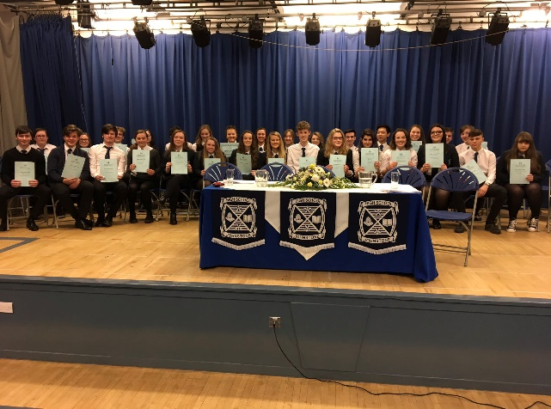
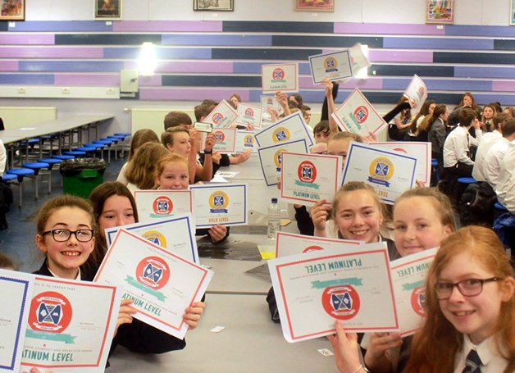
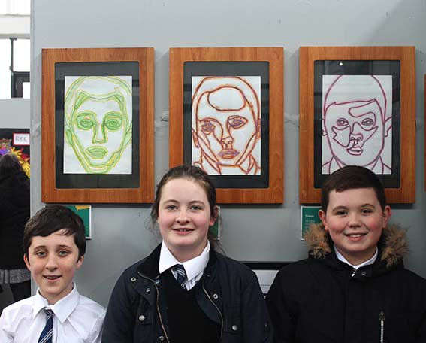
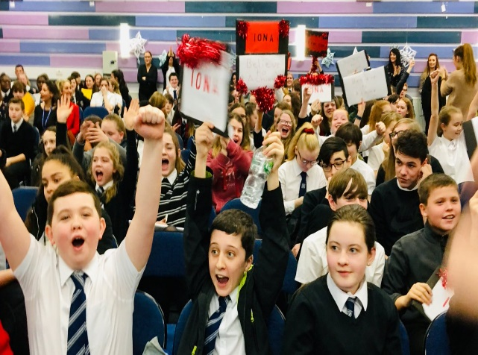
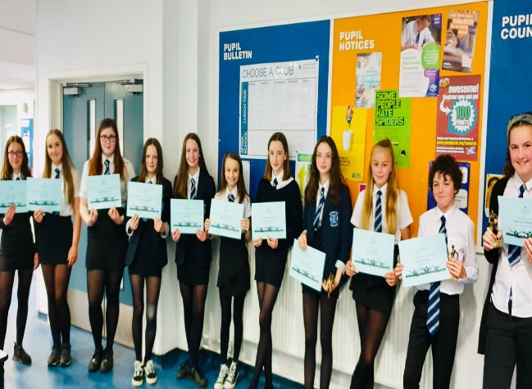
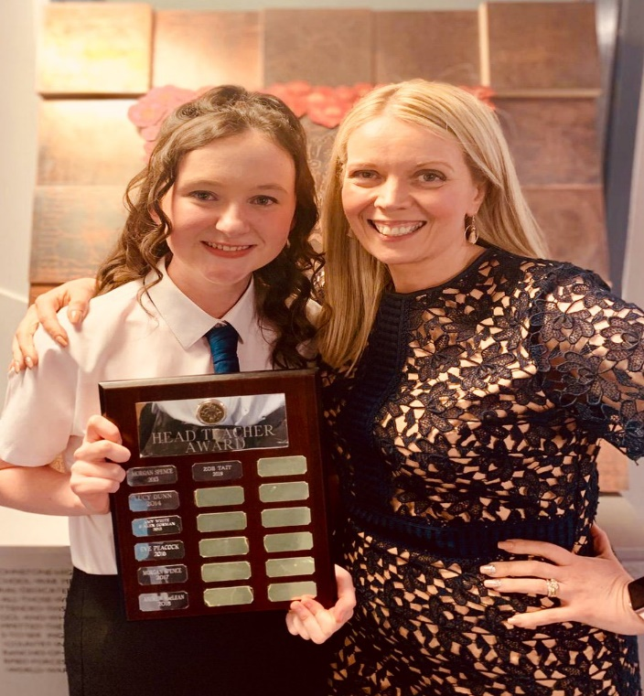
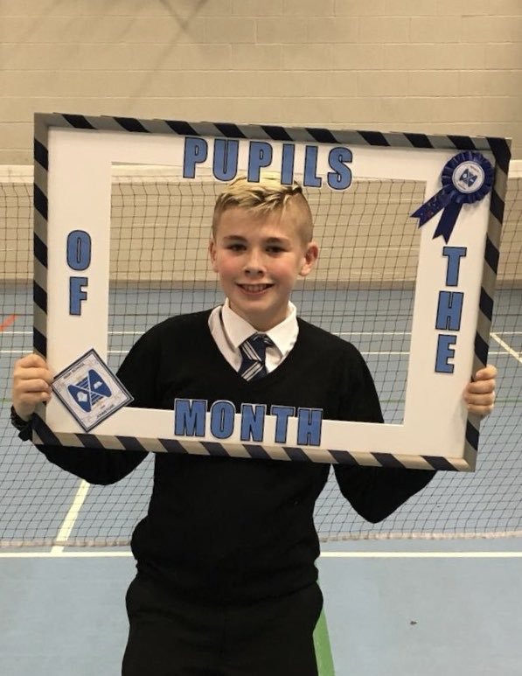
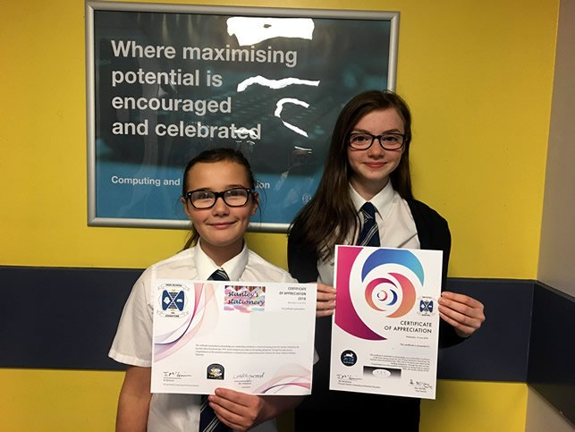
CELEBRATING SUCCESS

Slide 19
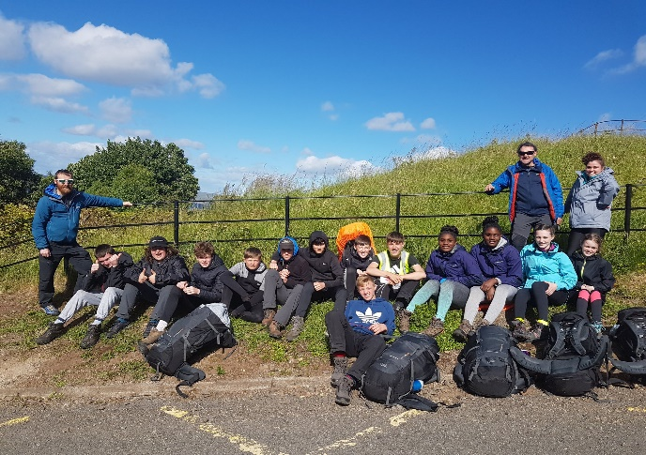
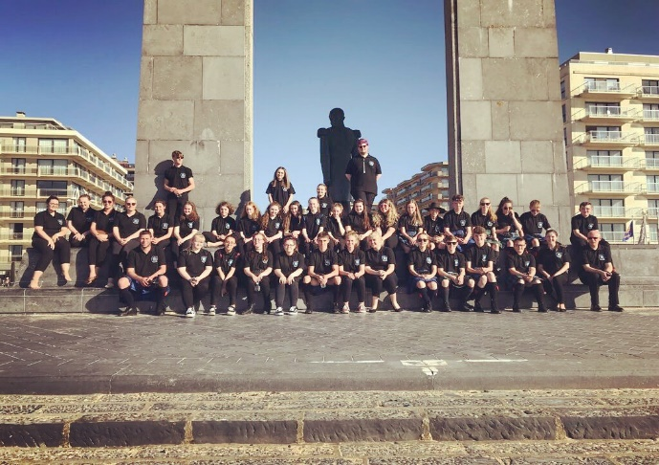
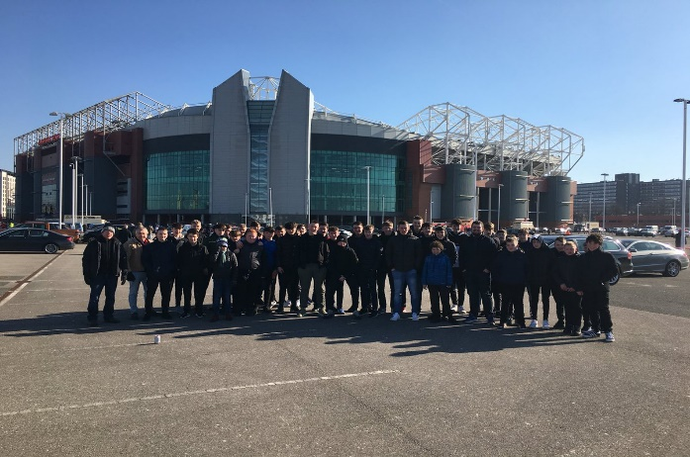
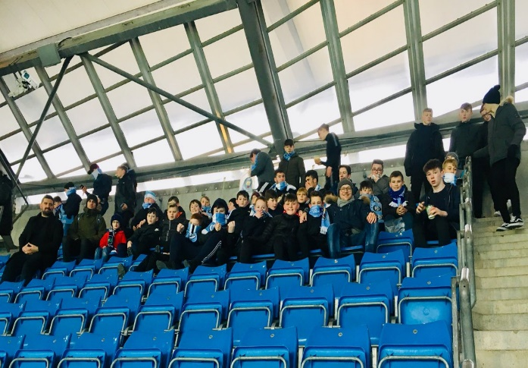
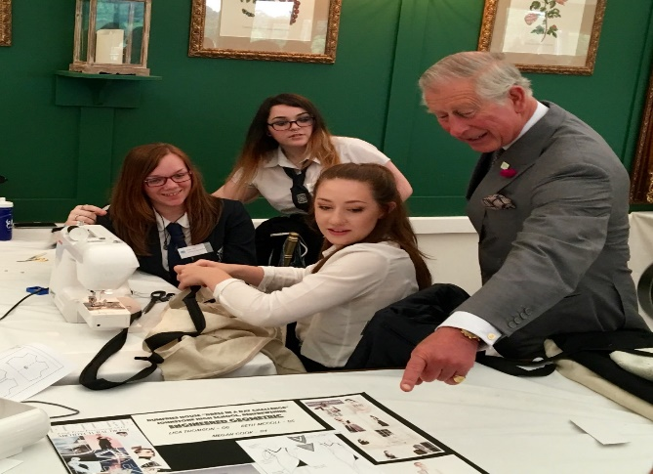
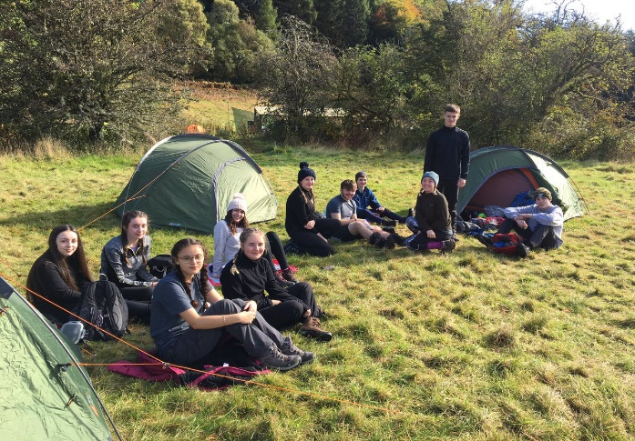
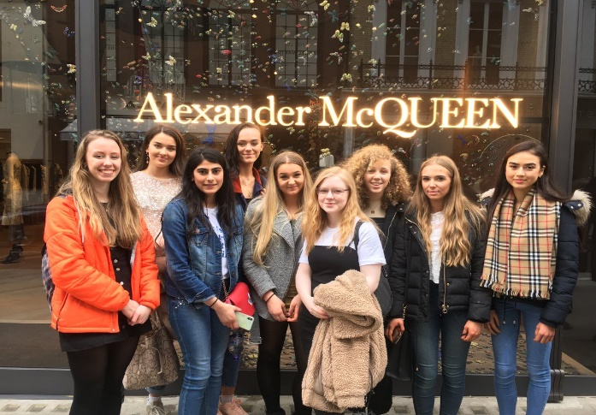
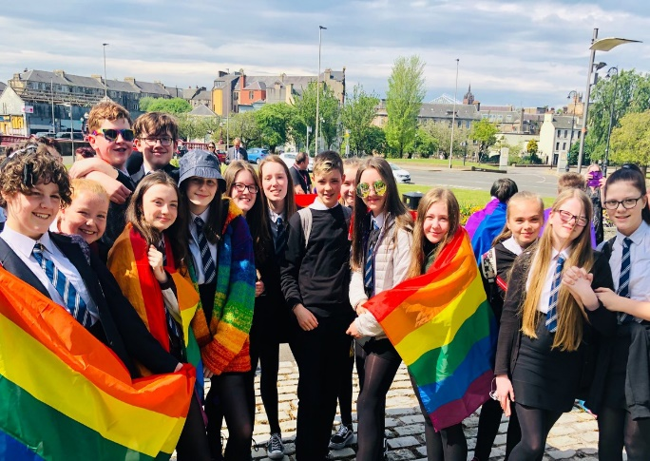
SCHOOL TRIPS

Slide 20
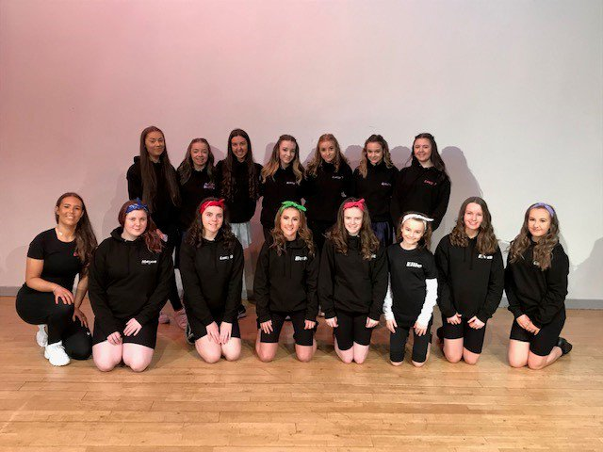
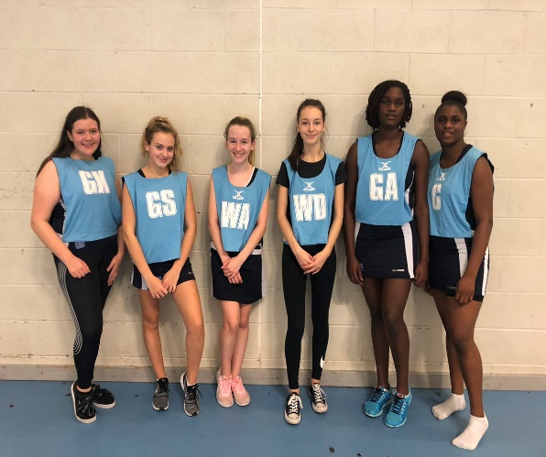
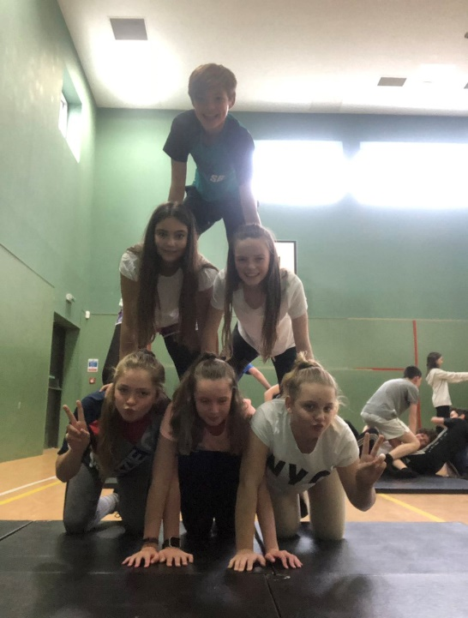
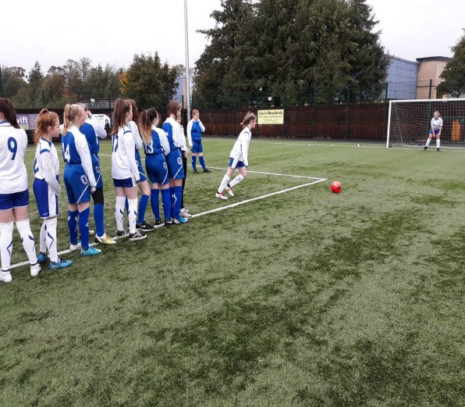
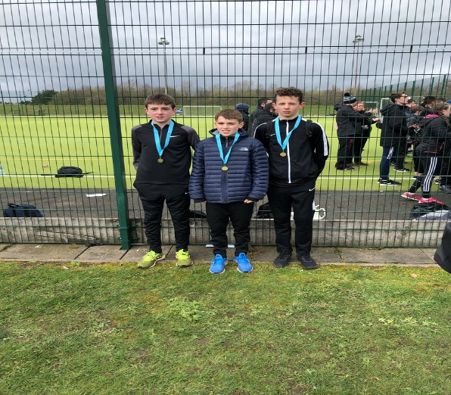
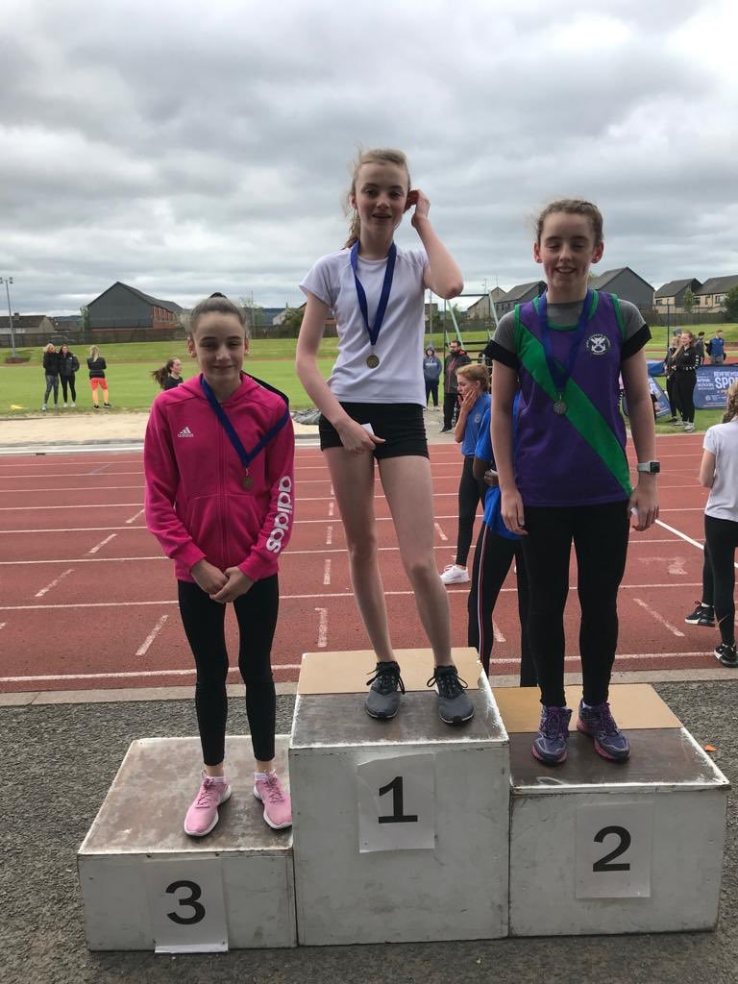
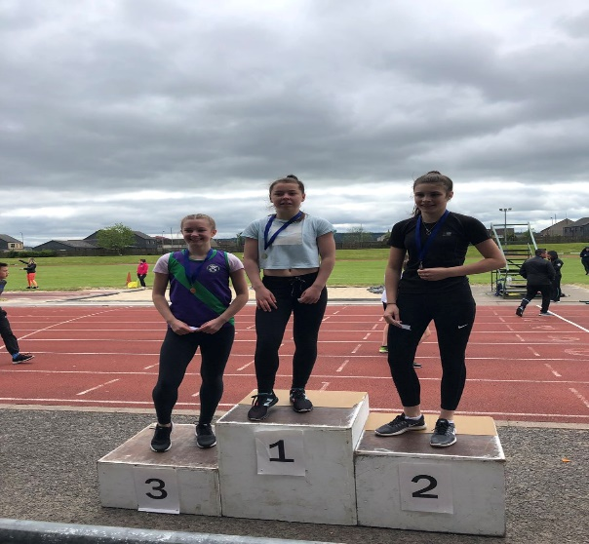
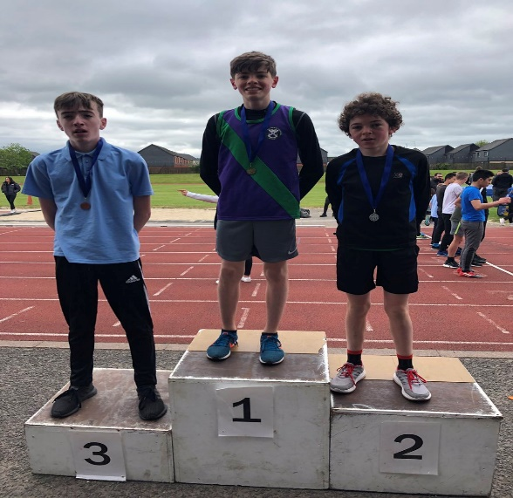
SPORTS

Slide 21
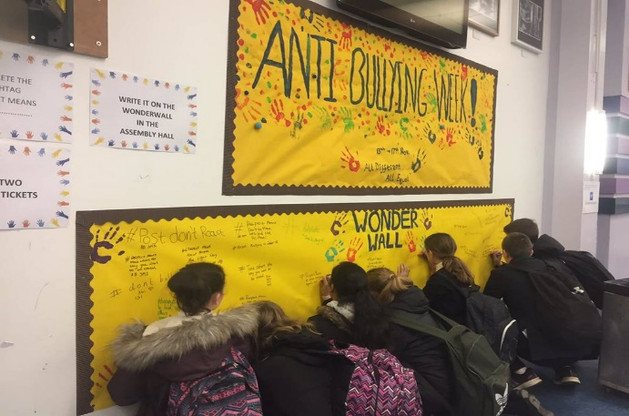
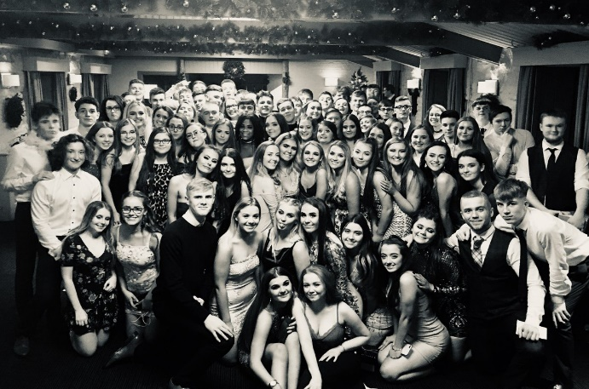
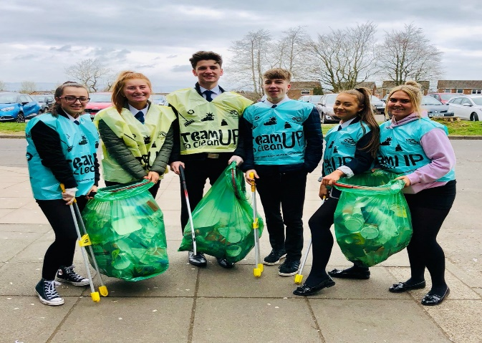
SCHOOL COMMUNITY

Slide 22
SCHOOL CLUBS

Slide 23
Transition Programme
October 2020 - Welcome to Johnstone High School presentation
November 2020 – Virtual Open Evening at Johnstone High School. Video link sent to associated primary schools
Spring 2021 -School handbook issued
February/March 2021 – Depute Head Teacher, Support For Learning and Pastoral staff visit Primary Schools (Information gathering)
1st June 2021 - Information Evening at Johnstone High School. (This may be virtual depending on COVID restrictions at that time)
9th, 10th & 11th of June 2021 - Three day induction visit for all P7 pupils (This may be virtual if COVID restrictions are in place)

Slide 24
Message from the school captains

Slide 25
Message from the school captains

Slide 26
Questions?

Slide 27
Welcome to the Johnstone High School Community Website: www.johnstonehigh.co.uk 0300 300 1331 Twitter: @JohnstoneHighSc Show My Homework app

