Slide 1
Parental Workshop
My Future
The role of Employability at Johnstone High School
Amanda Carlin

Slide 2
Welcome
Home Economics Teacher
Employability Project Leader
Since 2018
Previous Retail Manager

Slide 3
Workshop Agenda:
What is Employability?
Development of skills and qualities
Barriers to Employability
Role of Employability at Johnstone High
Partner's
Opportunities
Case Study
Foundation Apprenticeships
Modern and Graduate Apprenticeships
Apprenticeship Week – 1st to 5th March 2021
Updates and promotion of opportunities
Links to key websites

Slide 4
Employability

Slide 5
What is Employability?
“Employability is having a set of skills, knowledge, understanding and personal attributes that make a person more likely to choose and secure occupations in which they can be satisfied and successful.”
Dacre Pool & Sewell 2007
​

Slide 6
What are the skills and qualities Employers say are needed to secure employment?
Positive attitude
Communication
Teamwork
Self-management
Willingness to learn
Thinking skills (problem solving and decision making)
Resilience.

Slide 7
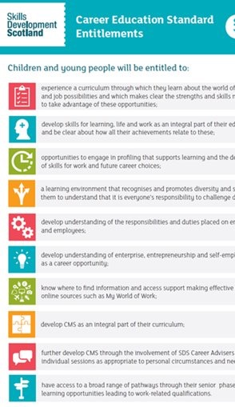
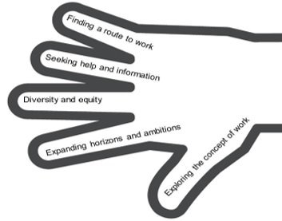
How do we make sure young people develop these skills and qualities?
Employability skills are the entitlement of ALL learners, but some who face barriers need more of a “Helping Hand”.​

Slide 8
Career education input by career advisor
P7 transition
S2 group
S2 subject choice
S3 group
S4 targeted interview
S5 targeted interview x 3
S5 Mod App group
S6 targeted interview x 3

Slide 9
Barriers to developing employability skills
Lack of self esteem
Poor literacy and numeracy skills
Lack of resilience or other mental health issues
Lack of educational engagement / attendance
Poor social skills
Long term unemployment within family

Slide 10
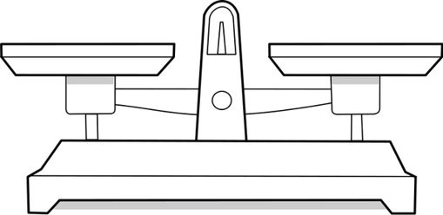
The challenge that Teachers face, is the balance between educational attainment and positive destinations.
Is one more important than the other?
Education
Destination

Slide 11
Role of Employability at Johnstone High
To offer support to young people who are facing barriers to employability.
To work with Pastoral Care, Careers Advisor and Education Department to offer the support and opportunities needed for a young person to move into a positive destination when they leave school.
To support Teacher's to deliver the Career Education Standards and highlight subject specific career opportunities.
To work with partners to provide increased opportunities for young people .

Slide 12
Partners
Who do we work with to support our young people?

Slide 13
Employability Opportunities
My Future Pathway: Construction
My Future Pathway:
Digital Manufacturing (August 2021)
TBC: Growth Sector Pathways - August 2021
Invest : Youth Guarantee 2021

Slide 14
Employability Opportunities
Career Ready
Two - year program (S5 & 6)
Mentor from Industry - Diageo
Paid internship (summer of year 1)
www.careerready.org.uk/scotland/

Slide 15
Employability Opportunities
Offered as subject choice for S5 & 6 young people
Links to employers and partners
Bespoke work experience and opportunities

Slide 16
Success story - Case study : Pupil a
WITH EMPLOYABILITY SUPPORT:
The "Helping Hand"
Work- place visits
Career Events
My Future Pathway : Construction
Hire me workshops
SDS input
Parental Contact
Employability programme
DYW Renfrewshire input
Invest input
CSCS Card
Registered with Invest
Secured MA Construction.
BARRIERS to EMPLOYABILITY
Poor school engagement
Poor literacy and numeracy skills
Long term unemployment in family
No work experience in S3

Slide 17
Foundation apprenticeships S5
Two year program at West College Scotland – Paisley Campus
Equivalent of a Higher
Digital Manufacturing
Civil Engineering
Creative & Digital Media
Business Skills
Social Services Children and Young People
KELLY.EWING@WCS.AC.UK

Slide 18
Foundation apprenticeship S6
One year programme in S6
Equivalent of Higher
Get an option to apply for accelerated entry to a Modern Apprenticeship
Accountancy
Social Services & Healthcare
Social Services Children & Young People
Engineering Systems

Slide 19
Modern and Graduate Apprenticeships
Earn while you learn
Available in many sectors
Gain a degree while earning – same as University Degree

Slide 20
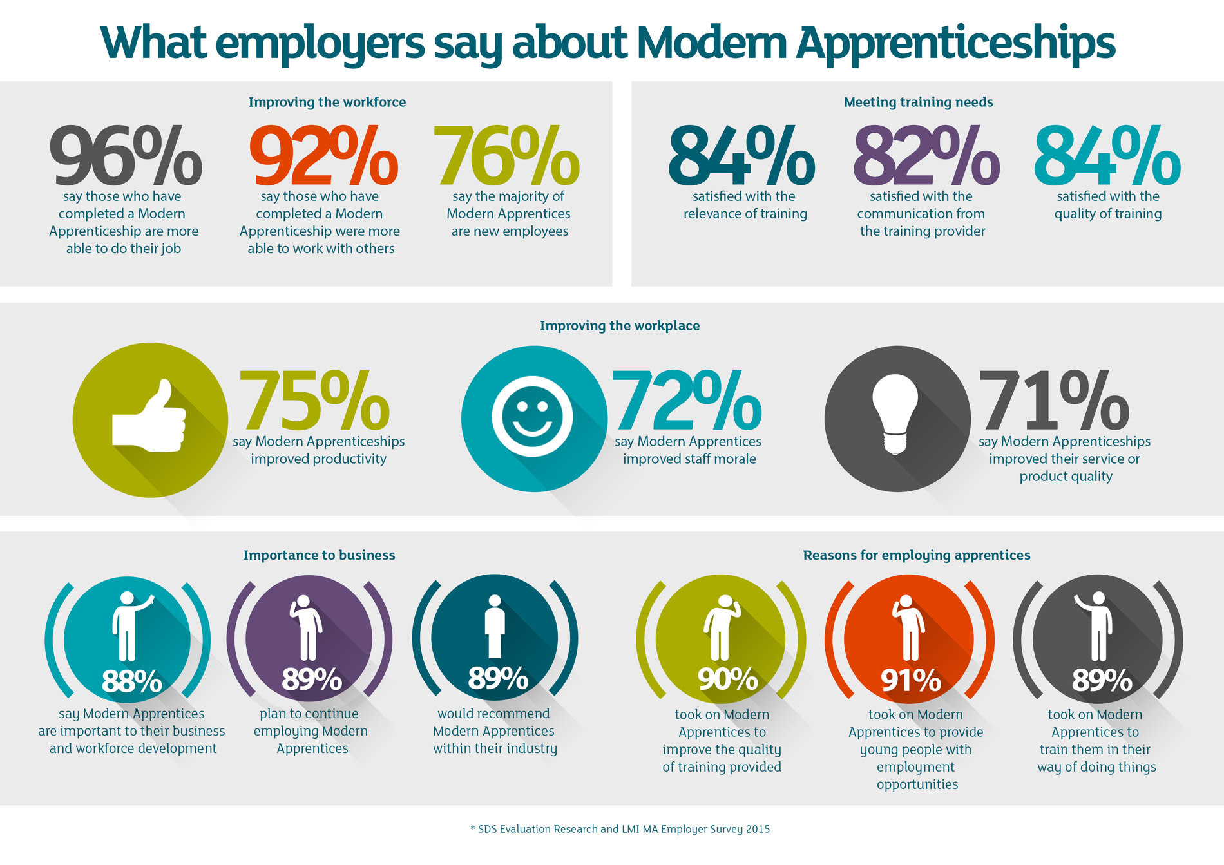

Slide 21
Modern Apprenticeship Week: 1st - 5th March 2021- www.Apprenticeship.scot
Date | Organisation | Sector | Time | Links/contact
Monday 1st March | Young Professionals: Host plus - EY, GSK, QA, HSBCuk, PWC, Capgemini, RAF | Accounting, Business, Technology, Finance, Pharmaceuticals, Marketing and Graduate Apprenticeships. | 4pm - 6pm | https://t.co/2QwBNlzmGu?amp=1
Monday 1st March | British Deaf Association and Skills Development Scotland | Modern Apprenticeships | 2pm : Live stream | https://t.co/gCucs0gU0G?amp=1
Monday 1st March | Skills Development Scotland Introduction to Apprenticeships | All : Clyde 1 hosts an overview of what it’s like to be an Apprentice | 2.30pm | https://www.myworldofwork.co.uk/marketplace/opportunities/1480-radio-silence-not-a-chance-lets-shout-about-apprenticeships
Monday 1st March | Skills Development Scotland Meet the Expert | Children and Young People | 2.10pm | https://www.myworldofwork.co.uk/marketplace/opportunities/1456-virtual-meet-the-expert-session--early-learning-and-childcare--modern-apprentice-in-children-and-young-people

Slide 22
Modern Apprenticeship Week: 1st - 5th March 2021- www.Apprenticeship.scot
Tuesday 2nd March​ | Skills Development Scotland Meet the Expert​ | Manufacturing: National Manufacturing Institute Scotland​ | 2.10pm​ | https://www.myworldofwork.co.uk/marketplace/opportunities/1469-virtual-meet-the-expert---national-manufacturing-institute-scotland---careers-in-manufacturing​
Tuesday 2nd March ​ | Skills Development Scotland Let's talk about Apprenticeships​ | What it’s like to be an Apprentice​ | 2pm​ | https://www.myworldofwork.co.uk/marketplace/opportunities/1477-lets-talk-about-apprenticeships-​

Slide 23
Modern Apprenticeship Week: 1st - 5th March 2021- www.Apprenticeship.scot
Thursday 4th March​​ | Skills Development Scotland Meet the Expert​​ | Life and Chemical Sciences: Biotechnology Innovation Centre​​ | 2.10pm​​ | https://www.myworldofwork.co.uk/marketplace/opportunities/1448-virtual-meet-the-expert-session---industrial-biotechnology-innovation-centre-ibioic---life--chemical-sciences​​
Thursday 4th March​​ | Army​​ | Movement to Work Programme​​ | 10am - 1pm: Virtual work experience​​ | https://meet82224173.adobeconnect.com/eati00i0hmm7/event/event_info.html​​
Friday 5th March​​ | Skills Development Scotland Meet the Expert​​ | Early Years and Childcare​​ | 2.10pm​​ | https://www.myworldofwork.co.uk/marketplace/opportunities/1455-virtual-meet-the-expert-session--early-learning-and-childcare--graduate-apprenticeship-in-early-learning-and-childcare.​​

Slide 24
Updates and promotion of opportunities

Slide 25
Links to key websites
www.Apprenticeship.scot
https://www.westcollegescotland.ac.uk/courses/foundation-apprenticeship/
https://careerfinder.ucas.com/jobs/
https://sites.google.com/re.glow.scot/myfuturepathwayren/home
https://www.myworldofwork.co.uk/
https://www.skillsdevelopmentscotland.co.uk/?gclid=EAIaIQobChMIo-qz6N2A7wIViuvtCh1reQ41EAAYASAAEgKA8fD_BwE
https://careerready.org.uk/scotland/
https://investinrenfrewshire.com/
https://www.dywwest.co.uk/Home

Slide 26
Thank you for your time
Any questions can be sent to the school office email:
johnstonehighenquiries@renfrewshire.gov.uk
For the attention of : Mrs Amanda Carlin

