Slide 1
Session 2020/21
Johnstone High School
Options Information Evening
Session 2020/21

Slide 2
Mrs Hollywood
HT

Slide 3
Overview
Why this information is so important?
Working in partnership with home
Personalisation and choice
Appropriate pathways
Skill development → post school transition

Slide 4
Positive and sustained destinations
School leaver destination figures are published annually.
Leaver destinations – The most up to date information available is for session 2018/19, where 94% of our leavers went on to a positive and sustained post-school destination.
This is in line with our other comparator schools and is an 8% increase since 2015.

Slide 5
Leavers 2018/19
Establishment | % Employed | % Further Education | % Higher education | % Training | % Unemployed seeking
Johnstone High School | 22.2 | 34.5 | 32.2 | 1.17 | 4
Renfrewshire | 23.9 | 25.7 | 41.6 | 2.6 | 4
National | 22.9 | 27.3 | 40.4 | 3.5 | 3
Early indications show are that 44% of our most recent leavers have moved onto University.

Slide 6
Positive and sustained destinations
There’s more than one path to success
“... there is a widespread belief that studying for a degree will lead to a well-paid job and fulfilling professional career and whilst in many cases this is true it isn’t always the case”.
Great Expectations, City and Guilds 2015

Slide 7
Work Based Learning
“.... our findings show that apprenticeships continue to suffer from an image problem compared to Higher Education”.
Parental preferences:
- higher education 51% , UK (56%, Scotland)
apprenticeship 20%, UK (19%, Scotland)
Young people’s preferences
“Only 7% of people aged 18-24 considered
apprenticeships as the best way forward”.
“It’s not about what kids do at 16, 17 and 18, it’s what they do at 6, 7 and 8”

Slide 8
Looking to the future
Scotland aims to be one of the top five performing countries in the EU for youth unemployment by reducing the youth unemployment rate to match the fifth best country in the EU by 2021
2014
19.0%
The rate of the fifth best country in the EU was 14.7%
2019
9.1%
The rate of the fifth best country in the EU was about 5%

Slide 9
Top influencers on learning and career choices
friends
media, including social media
teachers
parents and carers
extended family
SDS Careers Advisers
THIS MEANS THAT SCHOOL NEEDS TO WORK IN PARTNERSHIP WITH HOME TO ENSURE THE BEST OUTCOMES FOR OUR YOUNG PEOPLE

Slide 10
Sources of information
www.parentforumscotland.org.uk
www.apprenticeship.scot
www.myworldofwork.co.uk
www.westcollegescotland.ac.uk
www.johnstonehigh.co.uk
www.educationscotland.gov.uk
www.myworldofwork.co.uk - SDS website with career planning tools and information
https://www.myworldofwork.co.uk/parents/topics - Direct access to parent section
www.ucas.com/ - University entry system
www.ukcat.ac.uk/ - Test for medicine/dentistry
www.lnat.ac.uk/ - Test for Law
www.unistats.com/ - Statistics and information to compare Universities and courses
www.hecsu.ac.uk/ - Information on what graduates do
www.saas.gov.uk/ - Funding website
https://erasmusplus.org.uk/ - Study abroad

Slide 11
Mr Menzies
DHT

Slide 12
Subject Choices – points to consider for parents and carers
start talking and listening early
be open minded
get informed about subjects and associated careers
visit the parent and carer section of My World of Work
find out the choices available, including work-related learning options such as Foundation Apprenticeships
keep talking and listening.

Slide 13
Curriculum Setup
BGE – Broad range of subjects within 8 curricular areas
Maths, English, Languages, Sciences, Technologies, Expressive Arts, HWB & Social Subjects
S1-S2 pupils study within all curricular areas
S3 pupils remain within all 8 curricular areas but now have opportunity for personalisation and choice

Slide 14
Curriculum Setup
S4 – English, Maths plus 5 other subjects
S5 – 5 Subjects – Individual Pathways
S6 – Minimum of 4 subjects

Slide 15
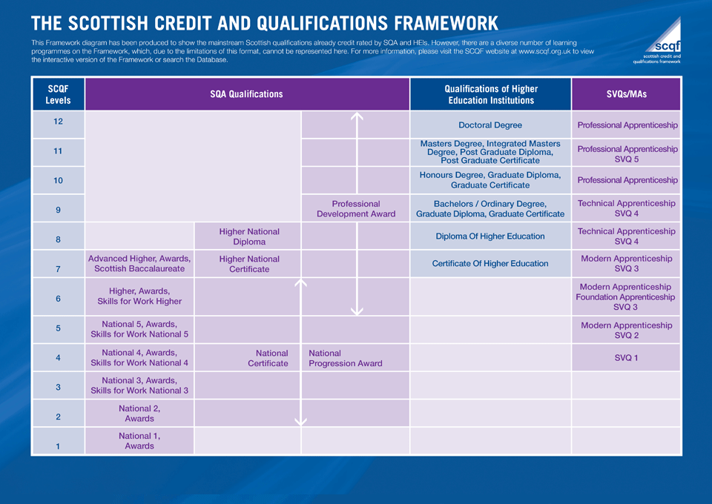

Slide 16
What to Consider When Choosing
Enjoyment
Where you will achieve success
Future aspirations
Tariff points

Slide 17
Tariff Points
SCQF Level | Grade | Tariff Points
6 (Higher, NPA level 6, Skills for work Higher) | A | 204
 | B | 182
 | C | 160
 | D | 149
5 (National 5, NPA level 5, Skills for work 5) | A | 84
 | B | 74
 | C | 64
 | D | 59
 | Individual Unit | 11
4 (National 4, NPA level 4) | Course Pass | 33
 | Unit | 7
3 (National 3) | Pass | 12

Slide 18
New Curricular Opportunities - BGE
BGE – greater focus on skills development with more focussed personalisation in S3
All course information available on the school YouTube site and school website
Dance | Admin and IT
Graphic Communication | Woodwork
Business Management | Design & Manufacture
Music Technology | Spanish
German

Slide 19
New Curricular Opportunities – Senior Phase
SP – Introduction of potential new courses:
All course information available on the school YouTube site and school website
Early Education & Childcare | Care
PC Passport | Cyber Security
Employability | SFA Referee Development
Politics (Higher) | Practical Cookery
Practical Cake Craft | Travel & Tourism
Psychology | Sport and Recreation
Health Sector

Slide 20
‘Dummy Run’ Process
Maximise personalisation and choice
Ensure viability
Plan around staffing

Slide 21
What Happens Next?
Options course information on YouTube rather than 90 page Option booklet from previous years. Any questions, please contact school.
Click link - https://www.youtube.com/channel/UC95T49m0tJRZn7LUY_YMwHg Pupils will participate in the Dummy run process in early January. Parents will be informed when this will happen through text message.
Where possible, please discuss options choices with your child before this process. YouTube channel has all the information.
Dummy run results will be collated and used to build options structure and form. Released in mid February
Materials placed on school website and option forms issued.
Parent and pupil interview over telephone with Pastoral teacher or DHT to finalise options– Late February/Early March
New timetable to begin TBC May 2021

Slide 22
Thanks for listening. If you have any questions, please contact the school, visit the website or School YouTube channel:
Johnstone High School Website
www.johnstonehigh.co.uk
Johnstone High YouTube Channel
https://www.youtube.com/channel/UC95T49m0tJRZn7LUY_YMwHg
To keep up to date on all that is going on at Johnstone High School, please follow us on Twitter @JohnstoneHighSc

