Slide 1
Session 2021/22
Johnstone High School
Options Information Presentation
December 2021

Slide 2
Mrs Hollywood
Head Teacher

Slide 3
Overview
Why this parent/carer information session is so important
Working in partnership with home
Personalisation and choice
Appropriate pathways
Skill development → post school transition

Slide 4
Positive and sustained destinations
School leaver destination figures are published annually.
Leaver destinations – The most up to date information available is for session 2019/20, where 92.3% of our leavers went on to a positive and sustained post-school destination.
This is one percentage point below our other comparator schools, however is a 6% increase since 2015.
Our leaver destination figure for 20/21 will be published by government in February 2022 and is looking to be considerably higher

Slide 5
Top influencers on learning and career choices
friends
media, including social media
teachers
parents and carers
extended family
SDS Careers Advisers
THIS MEANS THAT SCHOOL NEEDS TO WORK IN PARTNERSHIP WITH HOME TO ENSURE THE BEST OUTCOMES FOR OUR YOUNG PEOPLE

Slide 6
Sources of information
www.johnstonehigh.co.uk – everything you need to know about JHS
www.parentforumscotland.org.uk – general website for parents in Scotland
www.myworldofwork.co.uk - SDS website with career planning tools and information
https://www.myworldofwork.co.uk/parents/topics - Direct access to parent section, it contains links to info specific for S1 parents/ S2-3 re options / S4-6 re destinations
www.apprenticeship.scot – more on apprenticeships which have changed significantly from those 15+ years ago
www.westcollegescotland.ac.uk – West College Scotland website (has courses starting Jan 2022)
www.ucas.com/ - University entry system (deadline 15th Jan for August 2022 start)
www.ukcat.ac.uk/ - all about the mandatory test for medicine/dentistry
www.lnat.ac.uk/ - all about the mandatory test for entry for law
www.unistats.com/ - Statistics and information to compare Universities and courses
www.hecsu.ac.uk/ - Information on what graduates go on to do with their degrees
www.saas.gov.uk/ - SASS (uni and college) funding website
https://erasmusplus.org.uk/ - info on studying abroad

Slide 7
Mr Menzies
Depute Head Teacher (curriculum)

Slide 8
Subject Choices – points to consider for parents and carers
start talking and listening early
be open minded
get informed about subjects and associated careers
visit the parent and carer section of My World of Work
find out the choices available, including work-related learning options such as Foundation Apprenticeships
keep talking and listening.

Slide 9
Curriculum Setup
BGE – Broad range of subjects within 8 curricular areas
Maths, English, Languages, Sciences, Technologies, Expressive Arts, HWB & Social Subjects
S1-S2 pupils study within all curricular areas
S3 pupils remain within all 8 curricular areas but now have opportunity for personalisation and choice

Slide 10
Curriculum Setup
S4 – English, Maths plus 5 other subjects
S5 – 5 Subjects – Individual Pathways
S6 – Minimum of 4 subjects
Department/Faculty Pathways available

Slide 11
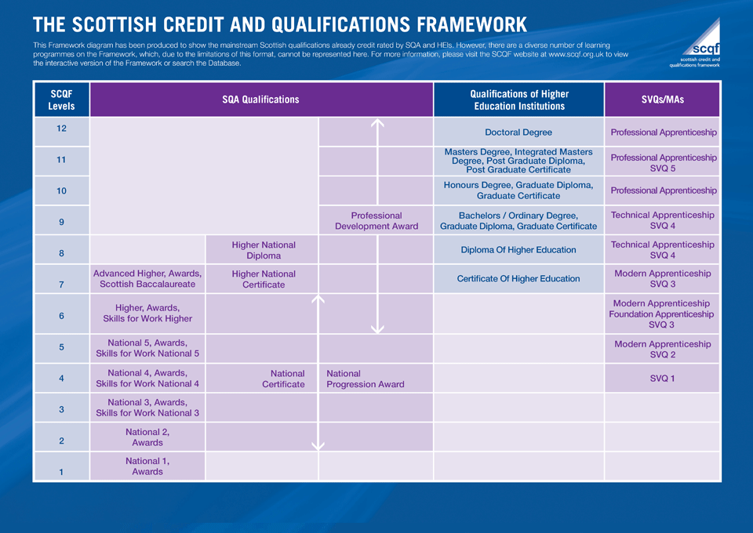

Slide 12
What to Consider When Choosing
Enjoyment
Where you will achieve success
Future aspirations
Tariff points

Slide 13
Tariff Points
SCQF Level | Grade | Tariff Points
6 (Higher, NPA level 6, Skills for work Higher) | A | 204
 | B | 182
 | C | 160
 | D | 149
5 (National 5, NPA level 5, Skills for work 5) | A | 84
 | B | 74
 | C | 64
 | D | 59
 | Individual Unit | 11
4 (National 4, NPA level 4) | Course Pass | 33
 | Unit | 7
3 (National 3) | Pass | 12

Slide 14
New Curricular Opportunities - BGE
BGE – greater focus on skills development with more focussed personalisation in S3
Admin & IT
Graphic Communication
Woodwork
Design & Manufacture
Business Management
German
Spanish

Slide 15
New Curricular Opportunities – Senior Phase
SP – Introduction of potential new courses:
Early Education & Childcare | Scottish Studies
Visual Communication | Cyber Security
Animation | SFA Referee Development
Art Triple Skills | Customer Service
Practical Cake Craft | Travel & Tourism
Psychology | Silversmithing & Jewellery
Health Sector | Joinery & Construction

Slide 16
New Curricular Opportunities – Senior Phase
SP – Introduction of potential new courses:
New Course taster sessions will be held in early January.
Creative Industries | Sports Development
Fashion & Textiles | Criminology
Science & Technology | Applied Science
Enterprise & Employability | Personal Finance
Leadership | Modern languages for Life & Work

Slide 17
‘Dummy Run’ Process
Maximise personalisation and choice
Ensure viability
Plan around staffing

Slide 18
What Happens Next?
New course information and department pathways available.
Pupils in S3-S5 will have the opportunity to learn more about the new courses available at the taster sessions in January.
Pupils will participate in the Dummy run process in mid January. Parents will be informed when this will happen through text message.
Where possible, please discuss options choices with your child before this process. YouTube channel and additional course presentation has all the information.
Dummy run results will be collated and used to build options structure and form. Released in mid February
Materials placed on school website and option forms issued.
Parent and pupil interview over telephone/face to face with Pastoral teacher or DHT to finalise options–Early March
New timetable to begin TBC early June 2022

Slide 19
Thanks for listening. If you have any questions, please contact the school, visit the website or School YouTube channel:
Johnstone High School Website
www.johnstonehigh.co.uk
To keep up to date on all that is going on at Johnstone High School, please follow us on Twitter @JohnstoneHighSc

