Slide 1

Johnstone High School
First day induction lesson
Johnstone High School
Celebrating Wider Achievement

Slide 2

Celebrating Wider Achievement
At Johnstone High School we want to recognise the vast array of skills, qualities, talent and commitment that our young people display both within school and across our wider community.
The JHS colours system is a way of recognising these wonderful achievements. As a school we are striving to gain more and more information about the wide and varied range of activities that our young people are involved in.

Slide 3
Why is celebrating Wider Achievement important ?
As a school, we aim to promote how valuable achievements are and how important it is for young people to have the opportunity to take part in activities.
Keeping a record of personal achievements and what a young person has been involved in will help to strengthen the personal/supporting statements that a child writes when they come to apply for training, college, university or jobs.

Slide 4
How will we celebrate Wider Achievement?
The colours system is designed to recognise/celebrate the achievements of pupils both in and out of school.
To be awarded colours pupils need to demonstrate commitment in order to be considered for an award. To celebrate the achievements of our young people we award four levels of School Colours in each of the following three categories:
Sports
Community
Creative

Slide 5
Johnstone High School
Colours Programme
Full colour
Half colour
House award
Personal Achievement
Personal Achievement Certificates, House Award badges, Half Colours ties and Full Colours ties are awarded to pupils in recognition of excellent performance or commitment in an extra-curricular activity.

Slide 6
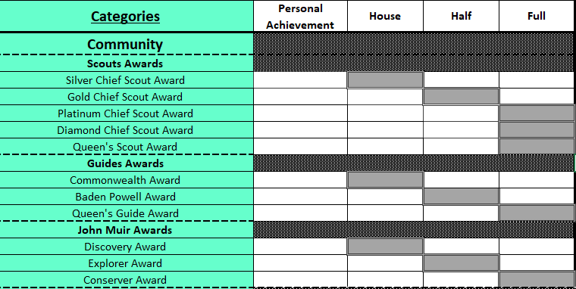
Colours Categories
Community category - examples

Slide 7
How will our young people be recognised?
Pupils will be entitled to wear Colours that represent their achievement.
Personal Achievement: Special Recognition Certificate
House Award: Special Recognition Badge
Half Colours: Silver Braided School Tie (single line)
Full Colours: Gold Braided School Tie (double line)
Wider Achievement award ceremonies twice yearly

Slide 8



Slide 9
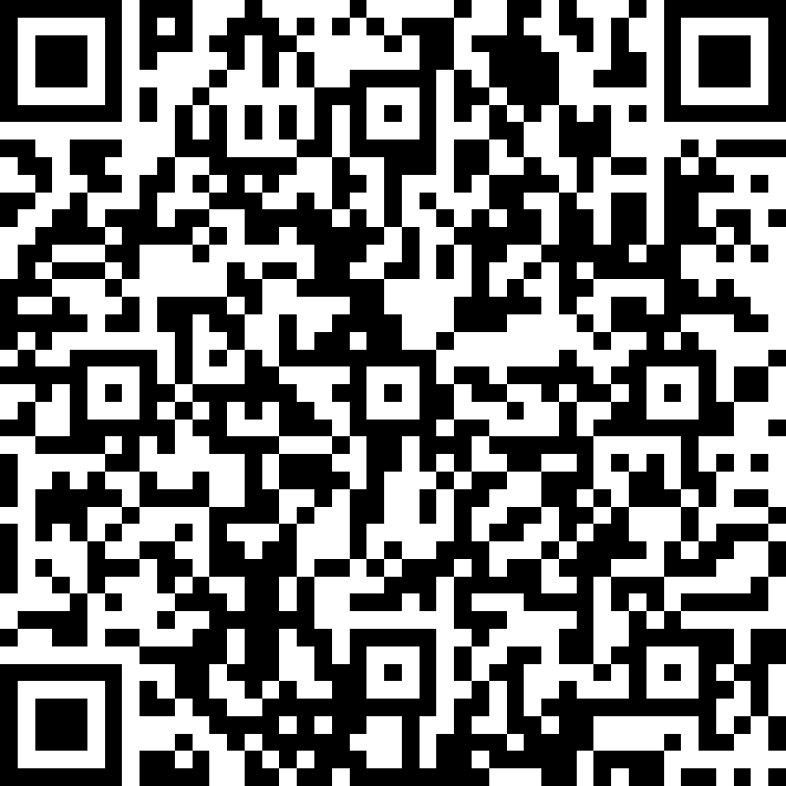
Colours Application
Pupils and parents can access the Colours application on the school website or by scanning the QR code below:
Pupils must log in using their GLOW user account details to access the form.
https://forms.office.com/Pages/ResponsePage.aspx?id=oyzTzM4Wj0KVQTctawUZKVp_9FTlxWhJpL2oiwVbcEhUMDJYV1I4MjJQVVFJTDA3VERWUklEQkQwRS4u

