Slide 1








FOUNDATION
APPRENTICESHIPS
In Partnership with

Slide 2
What is a Foundation
Apprenticeship?
A FA is part of the apprenticeship family.
It offers an alternative work based approach to learning.
It is completed as part of your school timetable.
It is recognised by Colleges, Universities and employers alike.
It requires commitment.
A FA is the equivalent of a Higher (SCQF level 6)
Is available to S5/6’s.
Two models available a two year programme and short duration delivery model (1 year).

Slide 3
How do they work?
1 or 2 year programme (starting in S5 or S6) to gain an industry recognised qualification
You will achieve a National Certificate or National Progression Award
You will complete SVQ units
It is at least 1 of your subject choices
It is a combination of school, college and work placement
There will be no cost incurred to pupils – e.g. travel expenses, PVGs etc

Slide 4
WCS Foundation Apprenticeships available in Renfrewshire 22/24
Frameworks | 2 years | SDDM
Social Services & Healthcare |  | ✓
Social Services Children & Young People | ✓
Accountancy |  | ✓
Business Skills | ✓ | ✓
Engineering Systems |  | ✓
Advanced Manufacturing Engineering | ✓
Creative & Digital Media | ✓
2 year model - Year 1 = 2 afternoons at college and year 2 will typically be 1 or 2 afternoons at college and 1 day work placement, Advanced Manufacturing Engineering - 4 afternoons at college in year 2 and block placement.
Shorter Duration Delivery Model – combination of 4 afternoons at college and 1 full day work placement. Engineering - three full days at college and block placement..

Slide 5



Progression Opportunities
Fast Track Modern Apprenticeship
Employment

Slide 6
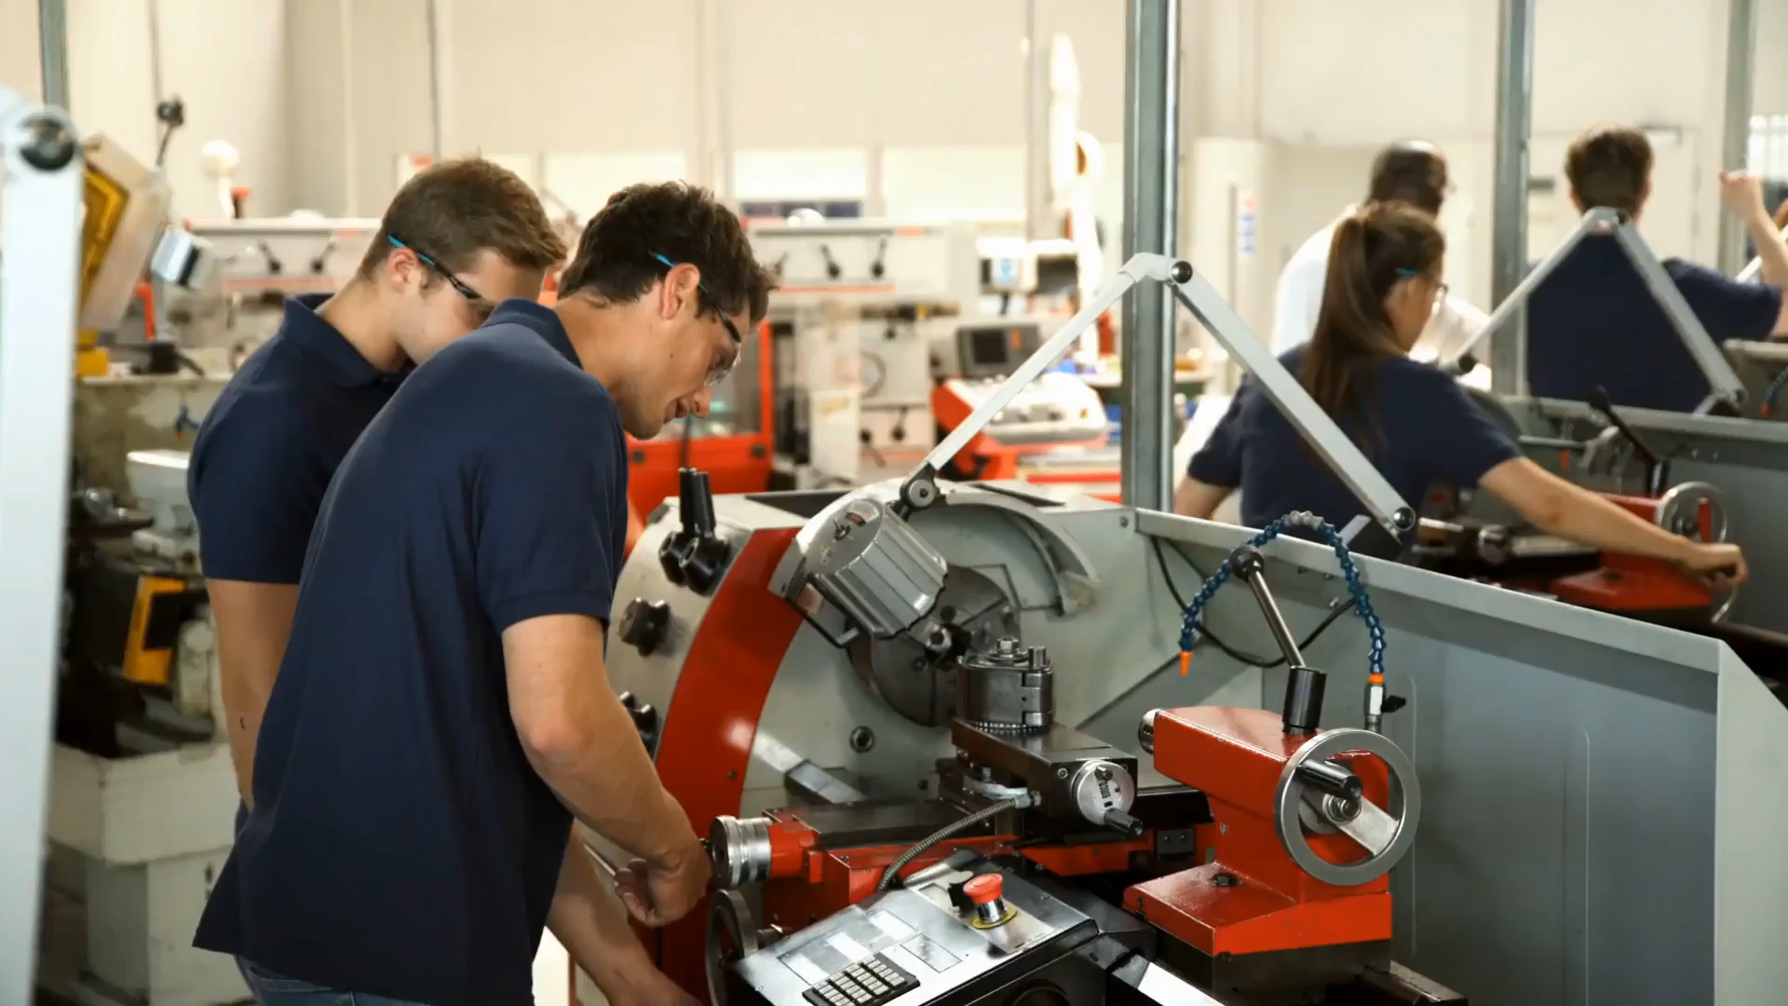
Progression Opportunities
College or University

Slide 7

Progression Opportunities
Graduate Apprenticeship

Slide 8

Progression Opportunities
Employment

Slide 9



















University Recognition
All universities in Scotland are accepting FAs as part of their entry criteria
Inverness
Aberdeen
Edinburgh
Glasgow

Slide 10
Eligibility Criteria
You should have a keen interest in your chosen framework
You must be capable of working at SCQF Level 6 (Higher)
Some frameworks require Maths, English or a Science subject
Good attendance at college and work placement
SQA Foundation Apprenticeship qualification will only be issued on full completion of the programme

Slide 11

Why should I apply?
Industry is telling education that something needs to change
Jobs require much more than academic ability
You will have experienced college life and gained valuable work experience
It will offer various pathways – MA/GA, college/university, employment
Your CV will stand out from the crowd
Higher Level – SCQF Level 6

Slide 12
Foundation Apprenticeship Level 4
Level 4 Automotive
One year course
Work based learning (work based challenge unit set by an employer)
Provides the opportunity for learners to engage with local employers.
Helps pupils gain work related technical and meta skills.
Develops skills for progression opportunities.

Slide 13
Further information
2023 offering to be confirmed.
For further information email:
Katrina.maxwell@wcs.ac.uk
Foundation.Apprenticeship@wcs.ac.uk
Visit the website:
https://www.westcollegescotland.ac.uk/courses/foundation-apprenticeship/foundation-apprenticeships-at-wcs/

