Slide 1

An Introduction to SCQF Qualifications
Parent/Carer Presentation

Slide 2

What is the SCQF
Is the National Framework for
qualifications in Scotland
Can help you to understand and
compare a range of qualifications.
It describes a Qualification by
giving it a Level to show how hard it is.
And a number of SCQF Credit Points
to show how much work is involved
Levels 1-12
1 Credit – 10 Hours

Slide 3
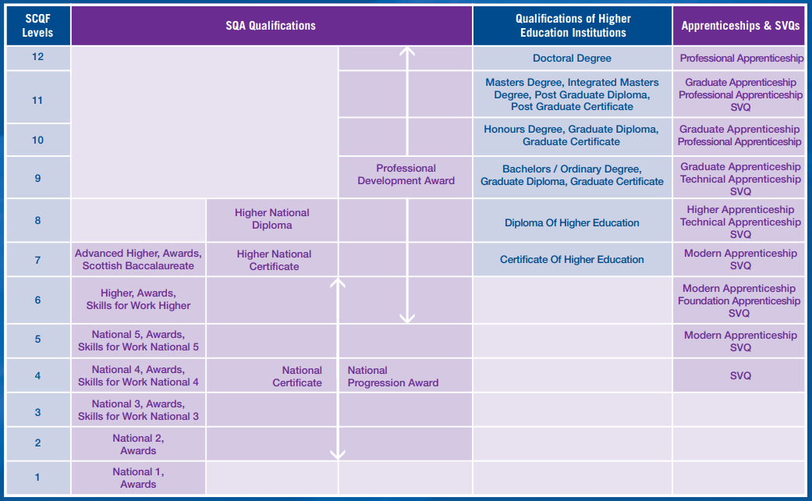
The SCQF Framework

Slide 4
The SCQF Framework
There are 12 levels to the framework
Starting at Level 1 which is the simplest qualification
Up to Level 12 which is the most complex

Slide 5
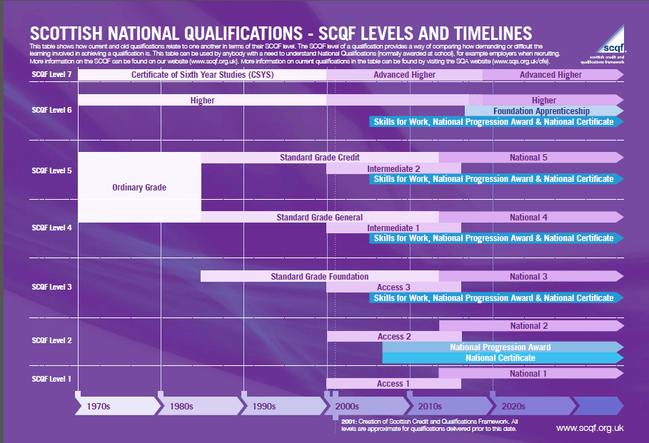
Previous Qualifications

Slide 6

Why do I need to know about the SCQF?
This information will appear on your son’s or daughter’s SQA certificate
The certificate will refer to SCQF levels
The certificate will recognise your son’s or daughter’s SCQF credits
1 credit = 10 hours of study
So the 240 hours of learning for a Higher is 24 credits.
1 Credit – 10 Hours

Slide 7
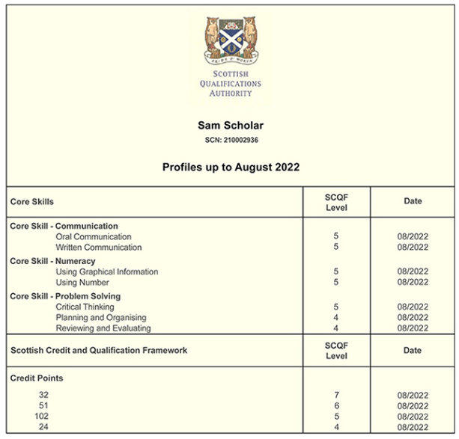
Why do I need to know about the SCQF?
Example SQA Certificate
Shows the SCQF Levels achieved
The Credit Points Achieved
Date of Achievements

Slide 8
How we use the SCQF in JHS
In Johnstone High School we have a range of qualification types and levels.
Including:
National Courses (Level 3-5)
National Progression Awards (Level 4-6)
SQA Awards (Level 4-6)
Higher (Level 6)
Advanced Higher (Level 7)
Personal Development Awards (Level 4-7)

Slide 9

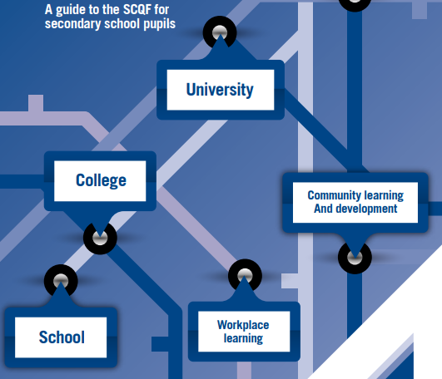
Creating Pathways
Creates progression pathways into:
University
College
Modern Apprenticeships Employment
Community Learning & Development
Points mean prizes
More SCQF Credit Points create more pathway options

Slide 10
Who else uses the SCQF?
Colleges and Universities
SCQF credit points help admissions officers in colleges and universities know exactly how much learning you have done and at what level.
This will be used along with other factors, such as the subjects you studied and grades you achieved.
College
University

Slide 11
Who else uses the SCQF?
Employers and Apprenticeships
SCQF helps employers understand the level of difficulty of each qualification, as well as the number of credit points you have achieved as part of your personal development.
As your career develops, any work-based qualifications you achieve may add to the number of credits you already have.
Employers
Modern Apprenticeships

Slide 12
Creating Pathways
There is no ONE PATH for our learners
We are looking to support learners in choosing the right path for them
“The framework is a FRAME not a LADDER there is not just one route to success.”

Slide 13

Where can you find out more?
Our School Website – SCQF Framework Menu

Slide 14
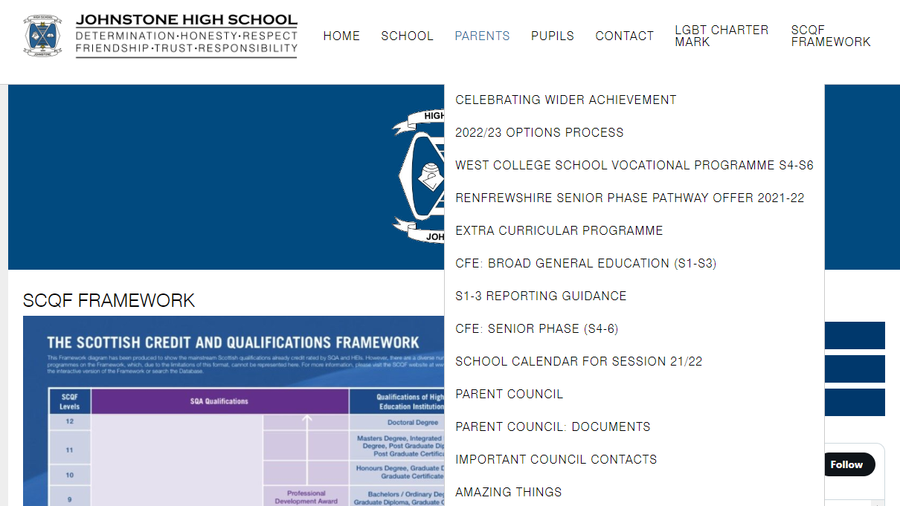
Where can you find out more?
Our School Website – Parents Menu

Slide 15
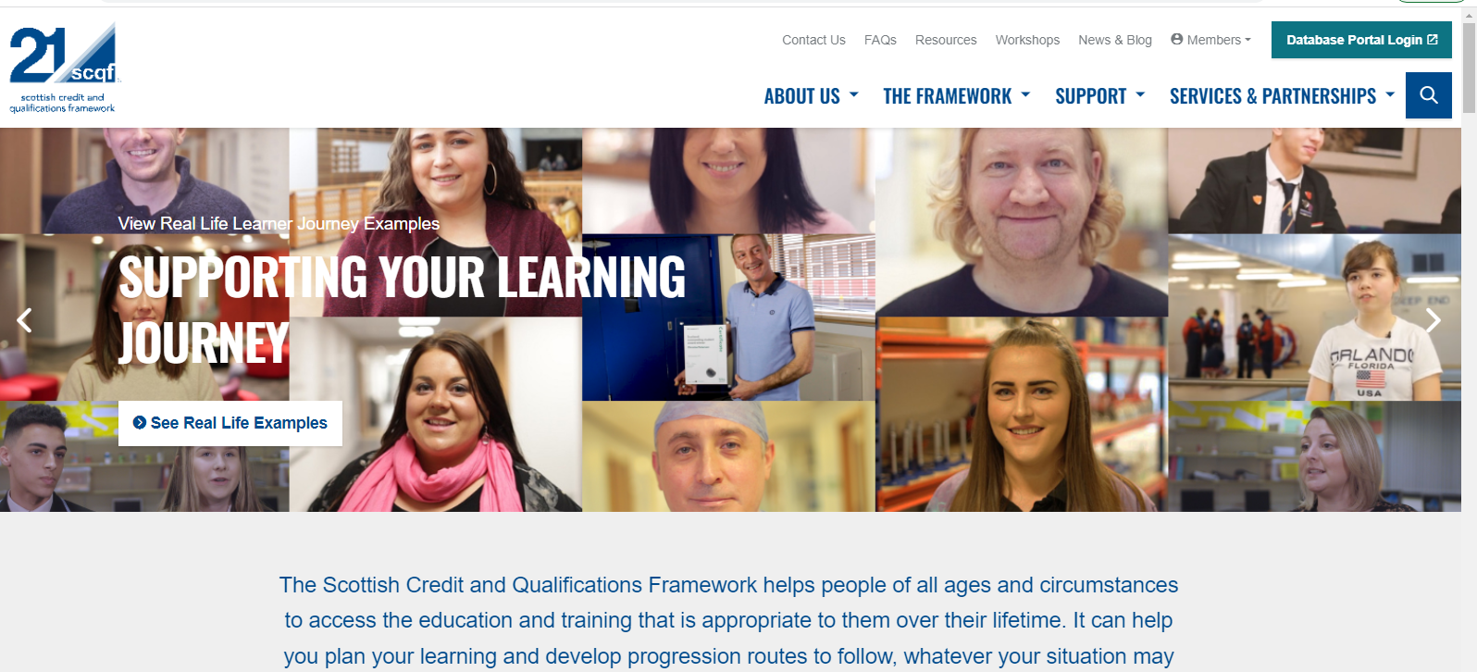
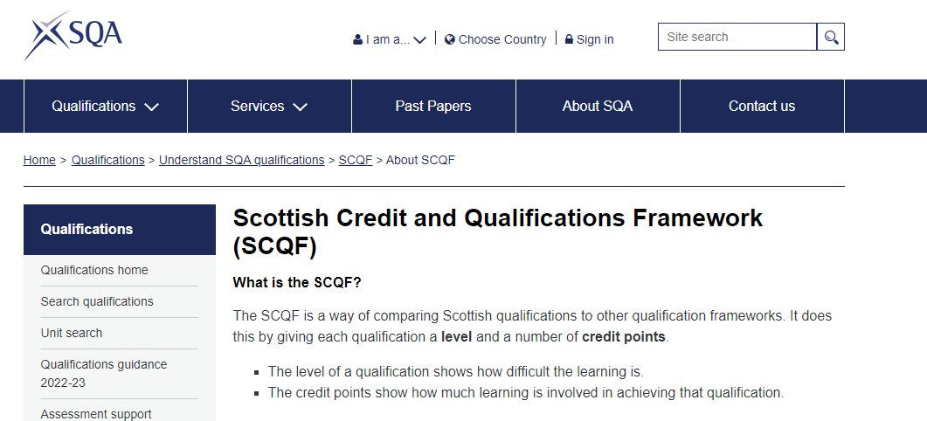
Where can you find out more?
SCQF Website
https://scqf.org.uk/about-the-framework/
SQA Website
https://www.sqa.org.uk/sqa/71387.html

