Slide 1

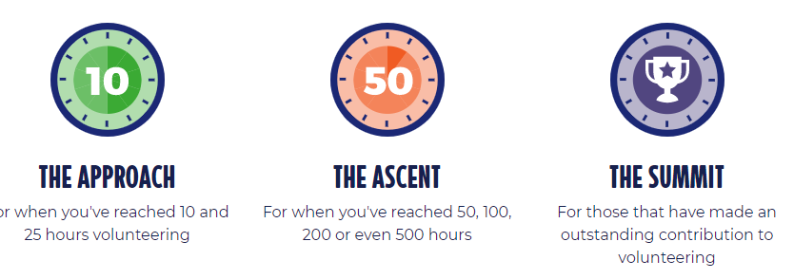
Saltire Award
This is an award which recognises “Youth Volunteering in Scotland”
It is awarded by the Scottish Government and is recognised by all universities and colleges across Scotland.

Slide 2

Saltire Award
In Johnstone High School we work with every S6 pupil to try and give volunteering opportunities and support them in achieving a Saltire Award.
In session 2021-22:
57% of our S6 Pupils achieved an award
They logged an outstanding 2732 hours between them

Slide 3
Saltire Award
This year we already have 64 pupils actively logging hours and we are excited to see how many pupils can achieve an award in session 2022-23
How does it work?:
At the start of S6 pupils register their interest with the link teacher (Miss Vernal)
That teacher registers them in the Johnstone High School Saltire Portal
They then log hours using an Hours Log Spreadsheet available in Teams
These are then signed off throughout the year by the link teacher
Their certificate will then be claimed at the end of June and sent out to pupils.

Slide 4
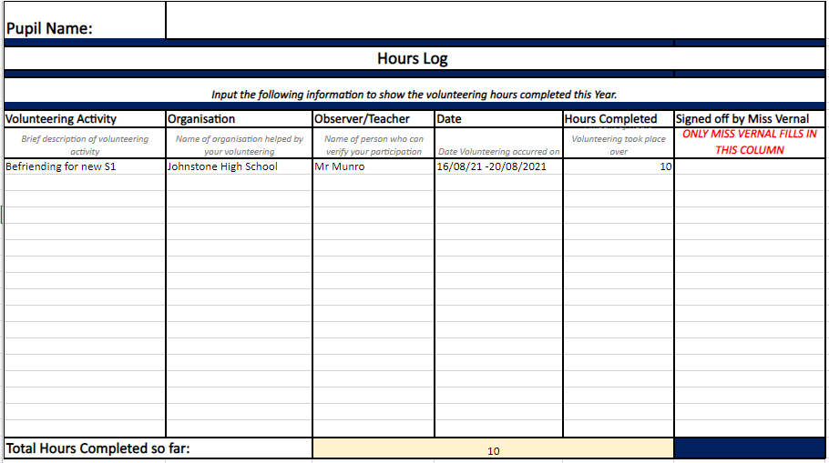
Saltire Award
How this works….
Pupils join a Saltire Team and log their hours via a Spreadsheet Log, set to them as an Assignment.
All volunteering counts be it in school or out with.
Notes:
If you are volunteering in the community or at a club then all you need to do is give the link teacher a contact name/ an email and a phone number so that they can verify this volunteering at various points throughout the year.

