Slide 1

Sleep
How to support your young person to develop good sleep patterns.

Slide 2
Why discuss sleep?
Poor sleep is linked with poor physical and mental health.
Good quality sleep can benefit a young person’s ability to study well, their relationships and behaviour.
The importance of sleep is discussed within our health and wellbeing curriculum.

Slide 3
The Presentation
This presentation will cover:
The importance of sleep for our physical, mental and emotional wellbeing.
The effects of sleep deprivation and poor quality sleep.
How to sleep well
How to raise the issue of sleep effectively at home.

Slide 4

What is sleep?
Sleep is:
Natural behaviour
Reversible state of reduced awareness
Dynamic
Lack of sleep affects our:
Emotional wellbeing
Physical health

Slide 5
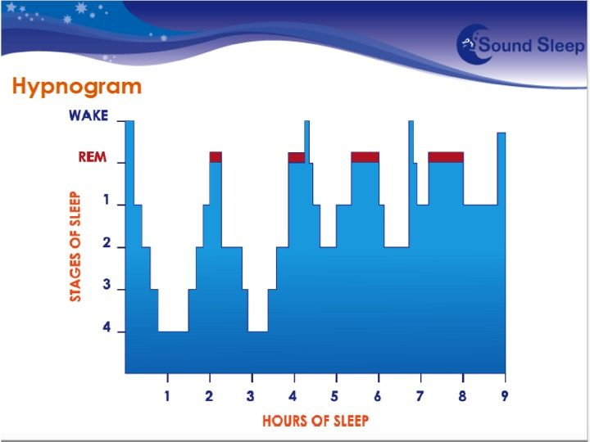
Sleep Patterns

Slide 6
Circadian Rhythm
Virtually every animal has a body clock that governs its circadian rhythm.
Our circadian rhythm controls many of our bodily functions including our sleep.
Our body clock prompts the release of two hormones which affect our sleep:
Melatonin
Cortisol
Changes that occur during puberty can disrupt a teenagers body clock and cause it to shift.

Slide 7
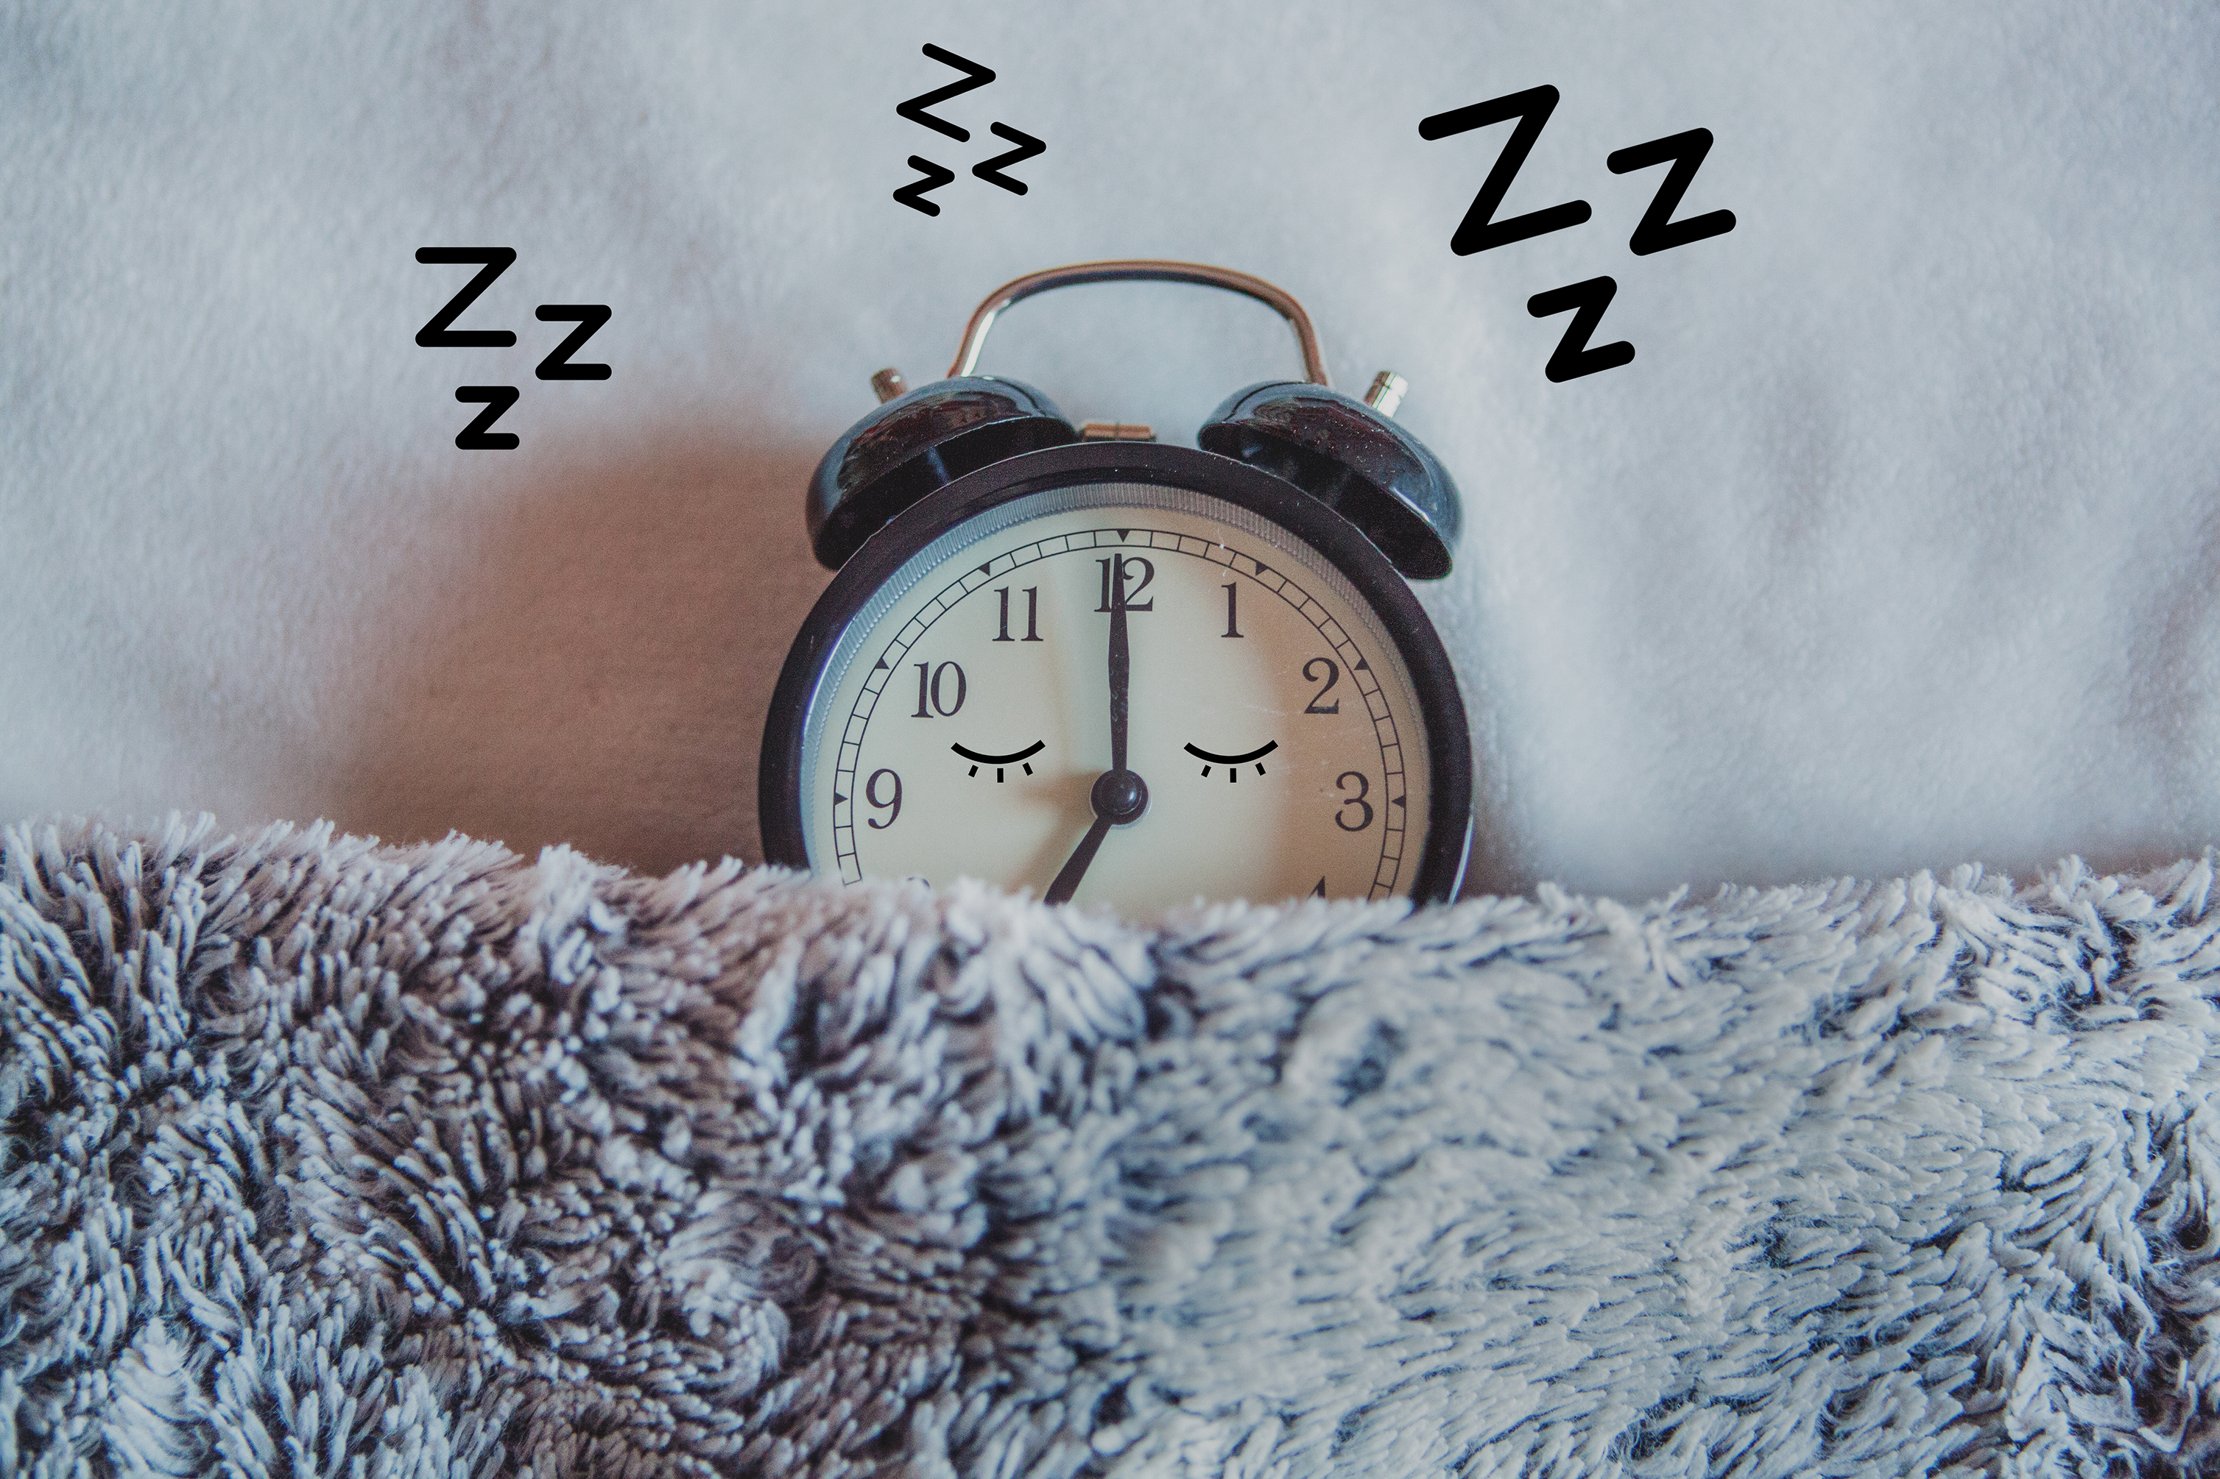
Teenage Sleep
Teenage sleep is different from children and adults.
Teenagers need 9 – 9 1/4 hours sleep per night.
Physical changes during puberty affect sleep.
Less than 9 hours may impact on physical and mental health.

Slide 8
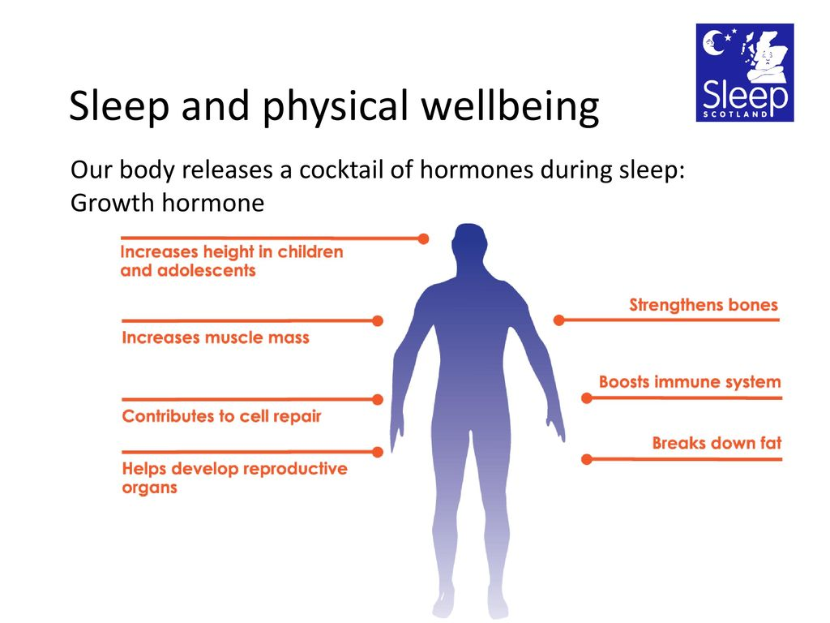
Sleep and Physical Wellbeing

Slide 9
Sleep and Mental Wellbeing
Different learning processes occur during different stages of sleep:
Memory consolidation
Vocabulary
Pronunciation
Auditory memories
Sleep is crucial for brain development during adolescence.

Slide 10

Sleep and Emotional Wellbeing
Sleep helps us with:
Crisis
Stress
Anxiety

Slide 11
The Effects of Poor Quality Sleep
- Obesity
During sleep, hunger levels and the breakdown of fat are affected by leptin and growth hormone.
Lack of sleep can lead to increased levels of hormones that increase hunger levels;
Ghrelin
Cortisol
Research conducted in the US, Canada and Australia have all shown that getting less than 8 hours of sleep a night can increase obesity in teenagers, by as much as 3 times.

Slide 12
The Effects of Poor Quality Sleep
- Mental Health
Sleep deprivation affects mood and emotions.
The store of positive memories is impacted by a lack of sleep.
Research has shown that there is a link between sleep deprivation and depression.

Slide 13

The Effects of Poor Quality Sleep
- Impaired Learning
Research has linked sleep deprivation to:
Lower attainment
Lower attention rates
Negative impact on learning

Slide 14
Jet Lag Effect
The jet lag effect occurs as a result of disruption to the body clock. It can result in:
Difficulty falling asleep
Reduced sleep time
Difficulty waking in the morning

Slide 15
Signs of a Sleep Deprived Teenager
Find it difficult to wake in the morning or sleep through an alarm. | Sometimes feel very down, stressed, anxious and unable to cope.
Bad tempered, cross and more angry in the afternoon. | Feel emotional and start crying for no reason.
Fall asleep spontaneously if sitting quietly. | Find it difficult to concentrate or focus in school.
Sleep longer at the weekend compared to school nights. | Use mobile phone or computer games after they have went to bed.
Often feel tired or lethargic during the day. | Hand/eye coordination is not good.
Accident prone, tripping over and dropping things regularly. | Find it difficult to control behaviour, take unnecessary risks and do silly things.

Slide 16
How to Sleep Well
- During the Day
Get into natural light for at least 30 minutes a day.
Avoid too many caffeine based drinks.
Find ways of dealing with stress and anxiety.
Avoid having a nap during the day.
Do not have a lie in at the weekend.
Keep a sleep diary for a couple of weeks.

Slide 17
How to Sleep Well
-During the evening
Have a good meal, but not too close to bed time.
Clear homework out the way as soon as possible.
Do any stimulating activities such as exercise, playing computer games and watching TV earlier in the evening.
Avoid alcohol within 6 hours of going to bed.
Avoid cigarettes or anything with nicotine content.

Slide 18
How to Sleep Well
-The last hour
Switch off TV, computer and mobile phone.
Have a bath and wind down.
Read or listen to relaxing music.
Try a relaxation technique.
Stick as closely to the same waking up and bed times as you can, even at weekends.

Slide 19
How to Sleep Well
-The bedroom
Keep the bedroom dark and cool.
Make sure the bed is comfortable.
Use subdued lighting.
Remove or pack away electronic devices.
Remove pets that are nocturnal from the bedroom.
Avoid using a very loud alarm.

Slide 20
How to raise the issue of sleep at home.
Be prepared for challenging questions.
Listen
Discuss
Negotiate
Support
Questions?

Slide 21

Questions?
sleepsupport@sleepscotland.org

