Slide 1
Supporting your Child’s Mental Health During Exams
Mr Alan Smith
Psychology Teacher and Project Leader Learning and Teaching
Miss Amy McFadden
Principal Teacher of Pastoral Care Mull (Acting)

Slide 2
What is the psychology of anger and stress?
Tips for supporting your child through exams
Tips for ensuring a positive growth mindset during study.
Prelim and exam day procedures.

Slide 3
Signs of stress in your children:
During the exam period you may notice your child displaying some of the following behaviours which would suggest they are feeling anxious or worried about exams:
worry a lot
feel tense
have headaches and stomach pains
not sleep well
be irritable
lose interest in food or eat more than normal
not enjoy activities they previously enjoyed
be negative and have a low mood
feel hopeless about the future
Notes:
During exam periods children may feel high levels of anxiety and stress, it is important that you as parents and careers are aware of the ways in which this worry might manifest itself in your children. We as a school are here to work with you and you children to ensure that they get through the prelim and exam diet in a way which allows children to perform to the best of their ability.

Slide 4
Anger
Anger is an emotion categorised by antagonism toward someone or something you feel has deliberately done you wrong. When you feel like you or someone you care about has suffered from an injustice, the resulting emotion is anger.
Anger can be a good thing. It allows us a way to express negative feelings or motivates us to find solutions to problems.
However excessive anger can cause problems.

Slide 5
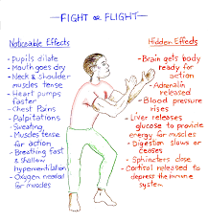
To Fight or Flight or Freeze…
Anxiousness and stress can cause a normal
biological response – called “Fight, Flight, Freeze”
although it has it’s uses, FFF can get triggered
inappropriately in the modern world.

Slide 6
What happens when we are angry?
Like other emotions, anger is experienced in our bodies as well as in our minds. In fact, there is a complex series of physiological (body) events that occurs as we become angry.
As you become angry your body's muscles tense up.
Inside your brain, neurotransmitter chemicals known as catecholamines are released causing you to experience a burst of energy lasting up to several minutes.
At the same time your heart rate accelerates, your blood pressure rises, and your rate of breathing increases. Your face may flush as increased blood flow enters your limbs in preparation for physical action.

Slide 7
Your attention narrows and becomes locked onto the target of your anger. Soon you can pay attention to nothing else.
In quick succession, additional brain neurotransmitters and hormones (among them adrenaline and noradrenaline) are released which trigger a lasting state of arousal.
You're now ready to fight.

Slide 8
We start to relax back towards our resting state when the target of our anger is no longer accessible or an immediate threat.
However, it is difficult to relax from an angry state,
The adrenaline-caused arousal that occurs during anger lasts a very long time (many hours, and in extreme circumstances days), and lowers our anger threshold, making it easier for us to get angry again later on. Though we do calm down, it takes a very long time for us to return to our resting state. During this slow cool-down period we are more likely to get very angry in response to minor irritations that normally would not bother us.

Slide 9
Now… the way in which we think can bring on anger and conflict.

Slide 10
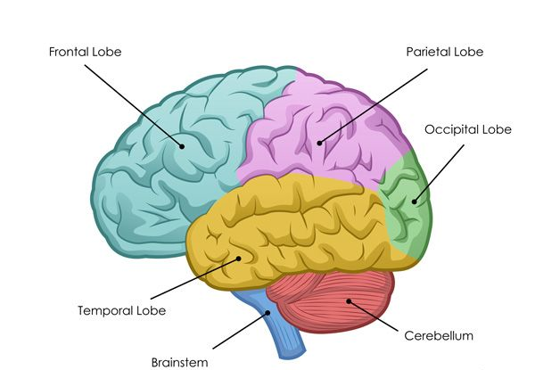
Ordinarily in day to day life our decision making would come from our rational pre-frontal cortex. However when we are angry and in our (fight response) our decision making occurs in our amygdala.
Prefrontal Cortex
Amygdala

Slide 11
Practicing mindfulness helps us think through our decisions and thought processes.
The more time we spend rationale thinking, instead of impulsive thinking, it has been shown that the prefrontal cortex actually increases in size and the amygdala starts to shrink. Smaller or weaker neural connections in the amygdala means we are less likely to interpret events as a threat.
Prefrontal Cortex
Amygdala

Slide 12
Top tips for supporting your young people…

Slide 13
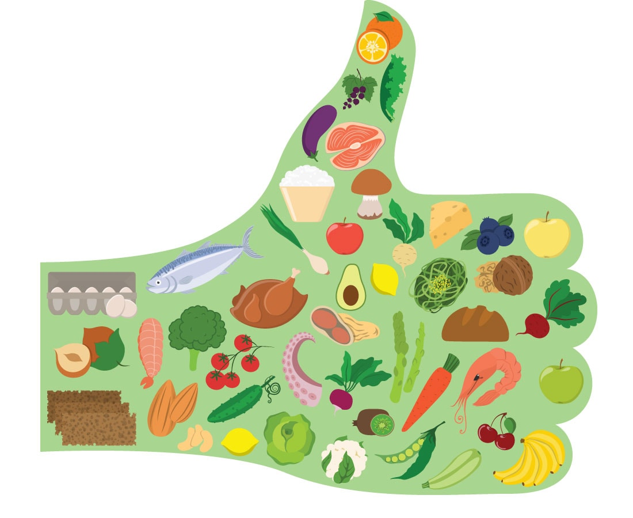
Make sure they eat well | Help to facilitate healthy sleep routines | Be flexible during exam time | Help with study timetable and activities | Talk about exam nerves
Encourage exercise during exam time | Be supportive and try not to add pressure | Make time for fun | Know when to get further help | Be positive

Slide 14
Supports Available

Slide 15
In School Supports
Class teachers/pastoral care teachers
RABs – encourage your children to attend these where needed.
Exchange counselling – ask your child’s pastoral care teacher to make a referral

Slide 16
Links to useful websites:
https://www.studentminds.org.uk/
https://www.ucas.com/advisers/guides-and-resources/adviser-news/news/exam-results-helpline
https://www.youngminds.org.uk/parent/parents-a-z-mental-health-guide/exam-time/
https://www.familylives.org.uk/advice/teenagers/school-learning/exam-stress
https://www.bbc.co.uk/programmes/articles/2Qf86MGyCkHlTq4h1tWfknn/advice-for-parents-whose-children-are-sitting-exams

Slide 17
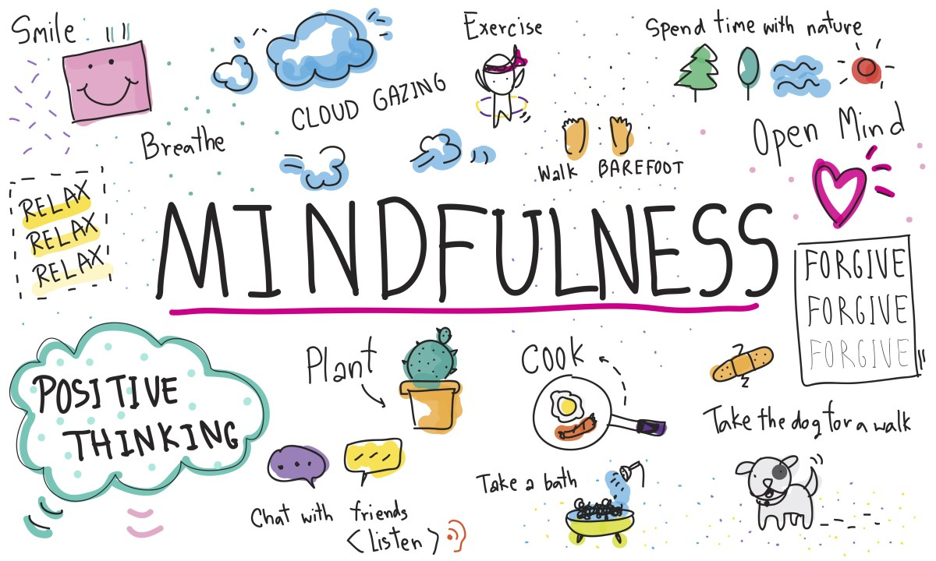
Practice mindfulness…it helps.

Slide 18
Resources
Keep the Heid Workshop Resources
Take the quiz, discover who you are in the Circus of Life and share your thoughts on how you Flip your Lid or Keep the Heid in conflict. Use one of the activity pages to get started or develop your own!

Slide 19
Resources
Monkey Vs Lizard Workshop Resources
Take the quiz and discover if you tend to use more of your Monkey Brain or Lizard Brain in any situation. Then why not use one of the activity pages to discover what part of the brain others around you are using!

Slide 20
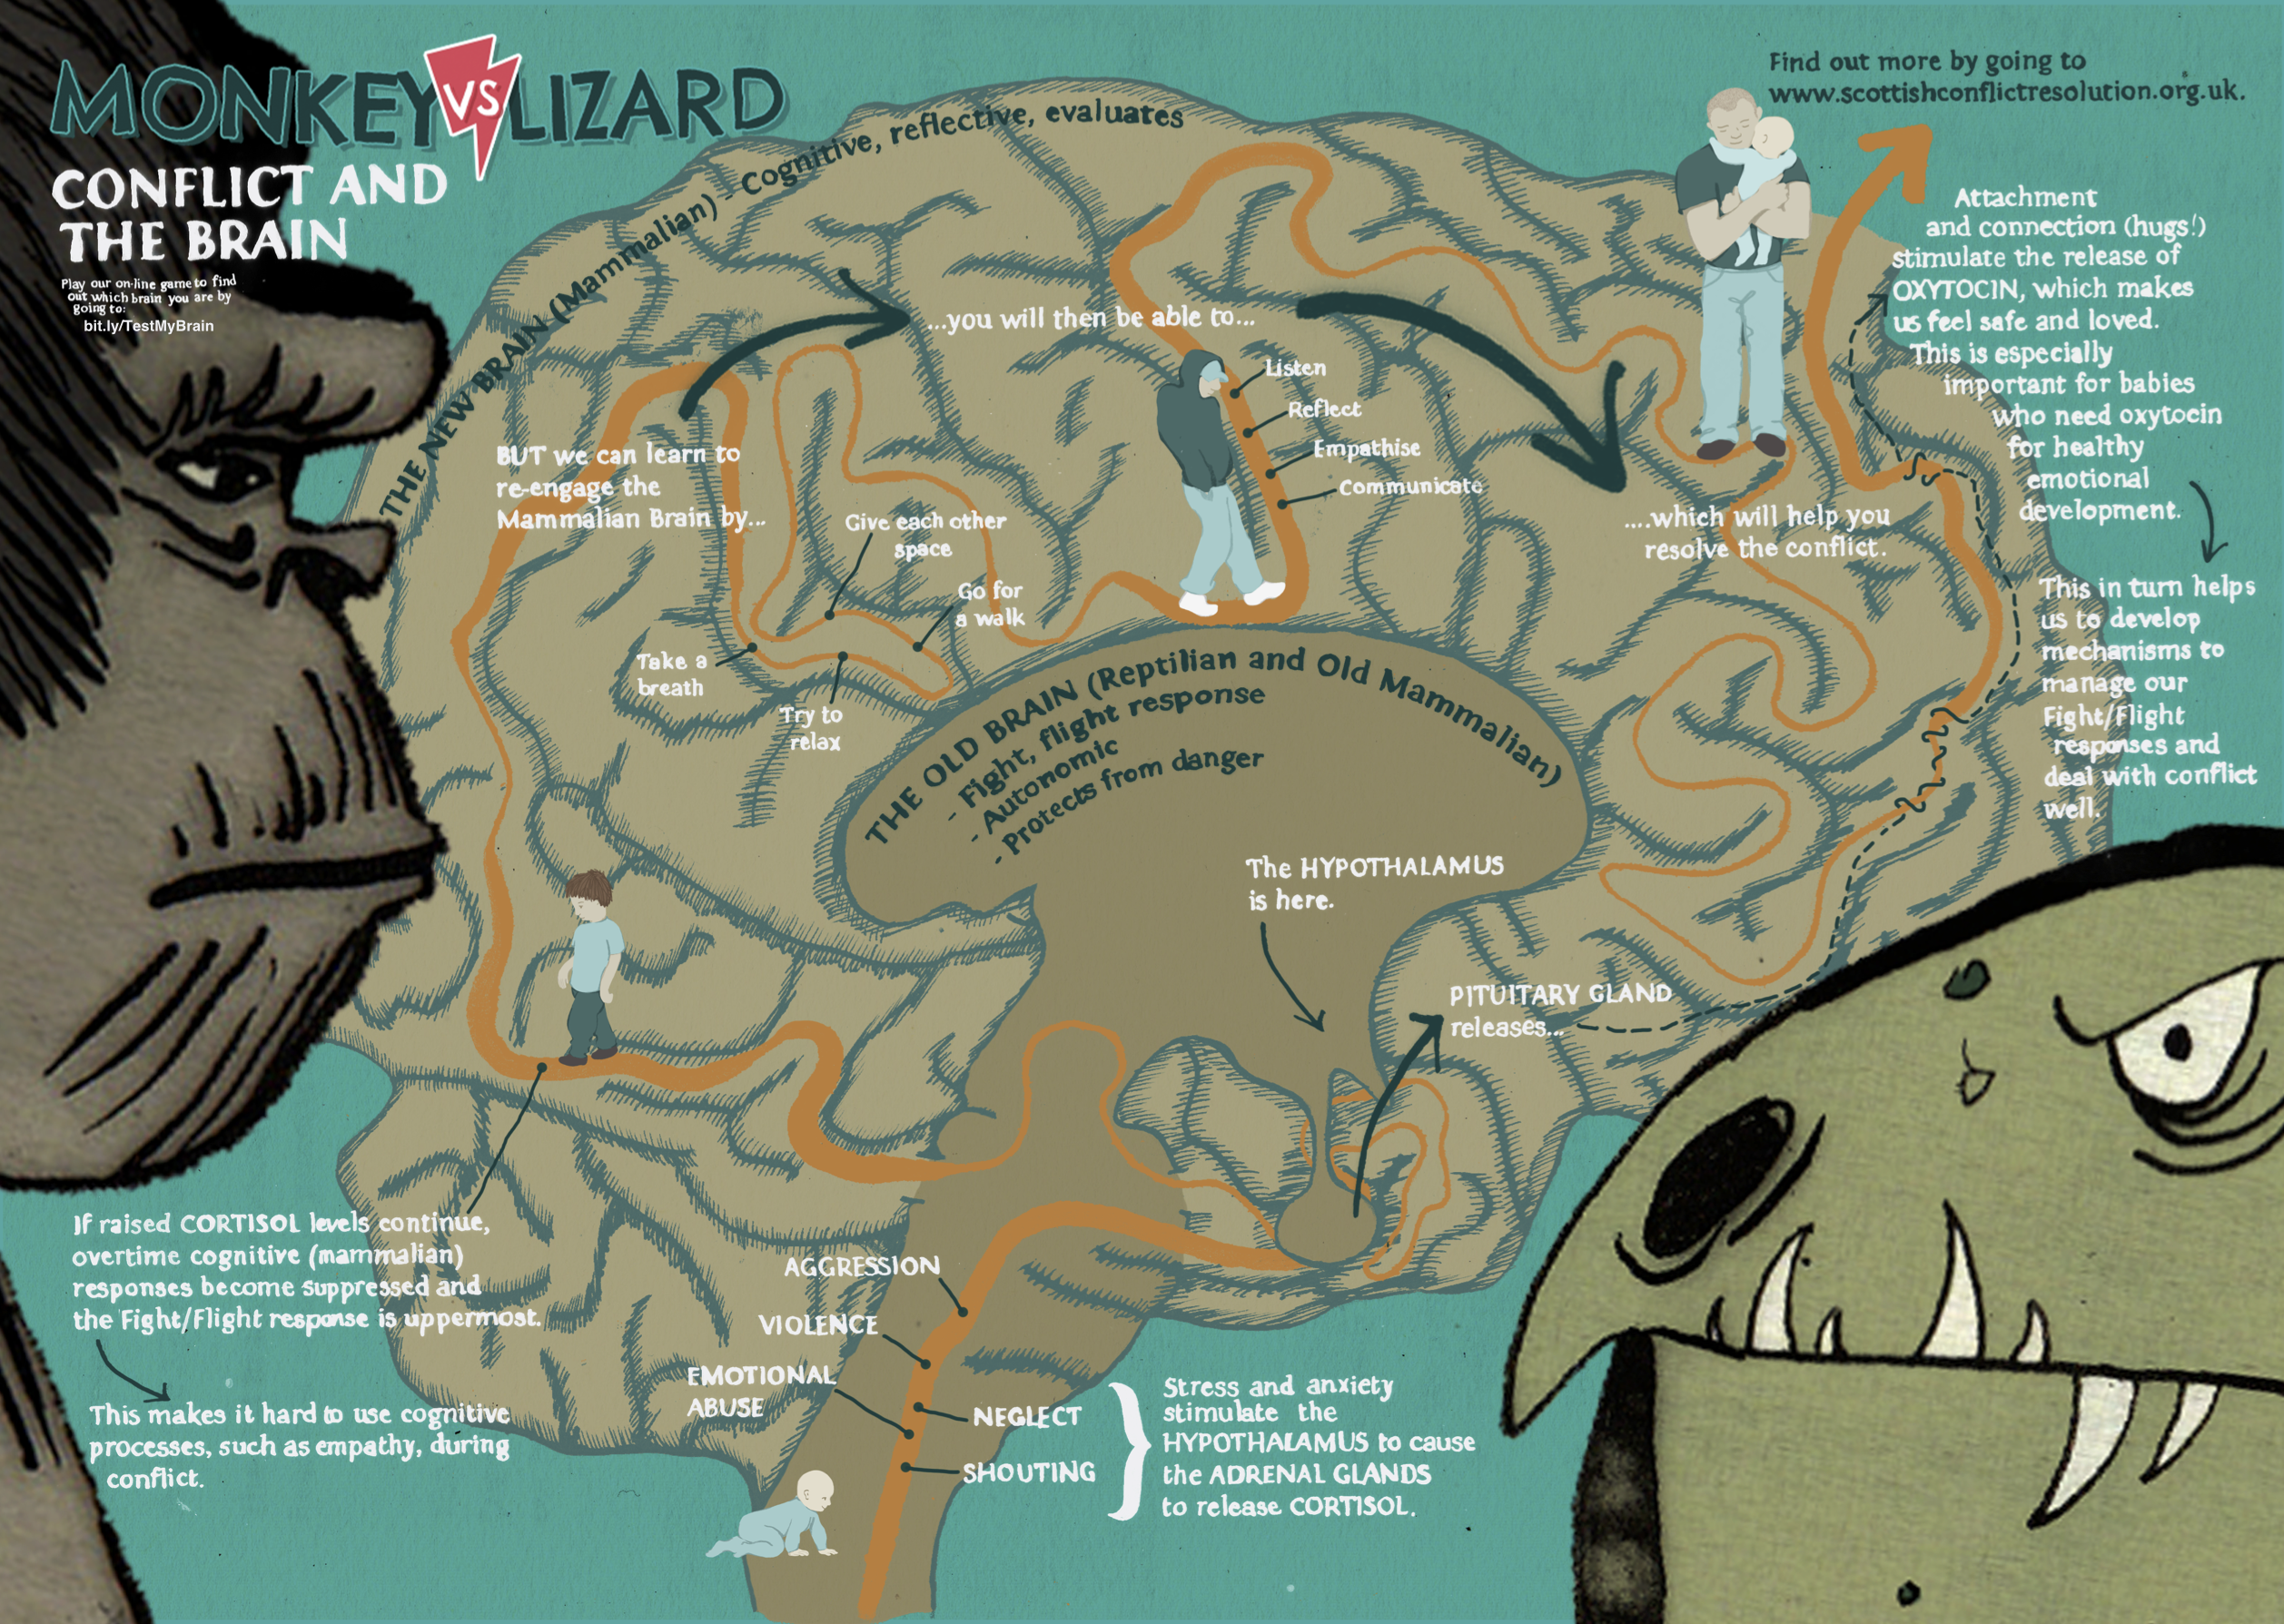

Slide 21
Exam Day Procedures

Slide 22
Prelims
Prelims – although less formal overall then the SQA exam diet, please treat it as a practice run for the real thing. Children will experience high levels of stress and will be feeling very anxious at prelim time. This is normal (especially for new S4).
It is important that children understand that prelims are an opportunity for them to practice for the real thing and that they will be supported through this.

Slide 23
Exam Day
On the day of your child’s exam:
Encourage them to eat breakfast
Ensure they have the equipment they need for the day
Ensure they have checked the time and location of their exam and seat number
Ensure they know their Scottish candidate number
Ensure they arrive at school in plenty of time for their exam
They should arrive at their exam location 10 minutes before the start time to take their seats and sign in.
If, for any reason your child is late for an exam, a member of the school leadership team will phone you to make you aware. You then have half an hour to get them to the exam. After this time pupils will not be able to sit the exam.

Slide 24
Any questions?
gw18smithalan@glow.sch.uk
amy.mcfadden@renfrewshire.school

