Slide 1
Study Skills in S4-S6
20th September 2022

Slide 2
Why Study?
National 5 and Higher Courses require:
160 Hours of Directed Learning (in school/assessments/exams) and 80 hours of self-directed learning ( homework, studying, supported study etc.)
Advanced Higher Courses require:
160 Hours of Directed Learning ( in school ) and 160 hours of self-directed learning

Slide 3
National 5/Higher/Advanced Higher
160 directed learning hours ( timetable runs June-May)
176 teaching days
Roughly 1 hour per day required for teaching and learning/assessments
A tight squeeze!

Slide 4
Self Directed Learning
80 Hours (N5/H) of studying/homework/practice given as guidance from SQA across the course.
224 days until start of the exam diet (32 weeks)
2.5 hours PER SUBJECT PER WEEK ( 36 mins per day)
(160 hours for advanced higher)

Slide 6
Pupils need to have a really clear plan of what they need to use their time for i.e. If a pupil has 1 hour of homework they should use the rest of the time to revise content or practice skills.
Pupils should have a schedule they follow- the more regularly and consistently they approach their work the easier it will be in class and in assessments.

Slide 7
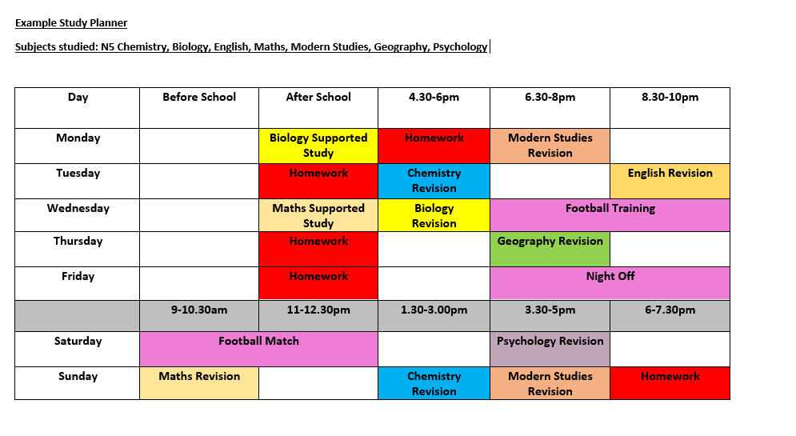
Study Planner

Slide 8
SQ3R – Study Method
Survey
Question
Read
Recite
Review

Slide 9
Survey
What can I learn from the text?
Before reading skim the material:
Skim the table of contents and find three to five main ideas that will be presented in the text.
Pay attention to names, headings and subheadings.
Look at the captions under images, tables, diagrams and maps.
Pay particular attention to the introductory and final paragraphs, which often contain a summary of the text.

Slide 10
Question
What do I hope to learn?
Before reading a section, formulate questions and do the following:
Rephrase headings into questions.
Look whether the author has formulated questions at the beginning or end of the section.
Recall what you already know about the topic and what you still want to learn about it.

Slide 11
Read.
Look for answers to your questions
Read captions under images and diagrams. Pay attention to highlighted information.
Be open-minded – pay attention to new ideas and differing opinions.
Stop and reread difficult and unclear parts.

Slide 12
Recite.
Consider what you want to remember from the information obtained.
Think about what you've read and summarise the main ideas expressed in the text.
If you realise there is something you have not fully understood, reread that section.
Take notes, expressing ideas in your own words.

Slide 13
Review.
Reread your notes and link the information with your own experience.
After reading the whole text, reread your own notes and pay attention to the main ideas and connections between the ideas.
Link what you have learned with your own experience and other sources of information.

Slide 14
How can I improve my memory?
Overlearn the Material.
Make It Meaningful
Don't Study Similar Subjects Together
Study Different Subjects in Different Rooms – if possible
Use Separate Study Sessions
Recitation
Active Learning.
Feedback
Concentration

Slide 15
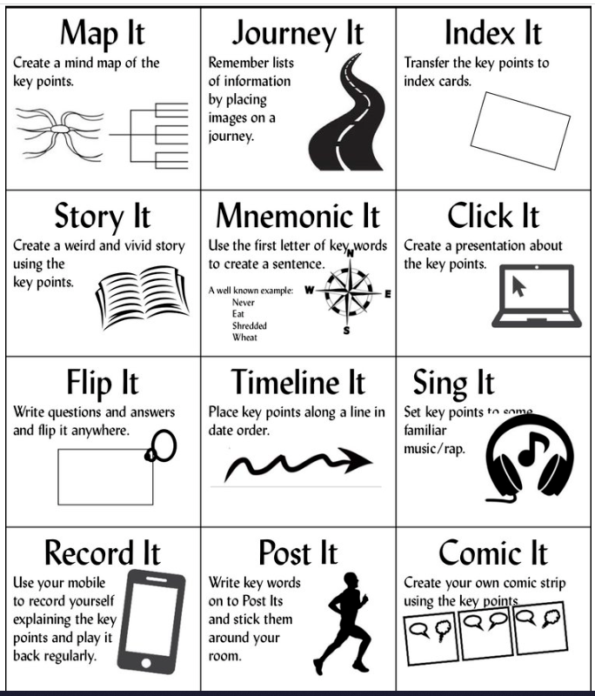
Mix It Up!

Slide 16
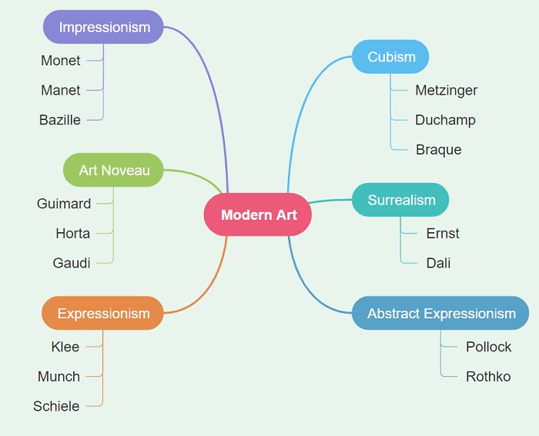
Spider Diagram

Slide 17
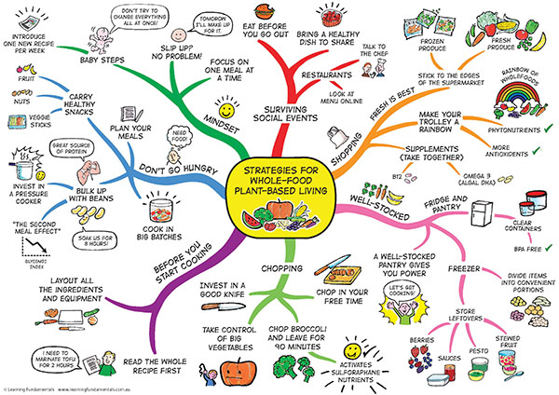

Slide 18
Mind Mapping can greatly boost productivity and creative thinking because the technique maps out your thoughts using keywords that trigger associations in the brain to spark further ideas
There is scientific evidence to suggest that this helps improve your memory.
These can be used to organise a lot of different ideas, for example different 8 Mark questions in English.
Mind-Maps
Use coloured pens/ highlighters to organise your thoughts.
These can be created on a computer.

Slide 19
Flash Cards
English
Quotation
Analysis
These could be used in almost every subject and can be bought in most supermarkets or made out of plain card.
Music
Concept
Definition
Maths
Formula
When to use – simple steps

Slide 20
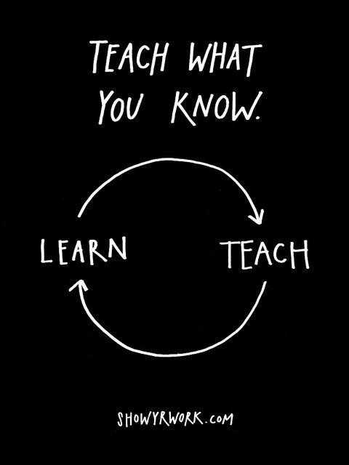
Teach Someone Else
The learning-by-teaching effect has been demonstrated in many studies. Students who spend time teaching what they’ve learned go on to show better understanding and knowledge retention than students who simply spend the same time re-studying.
Please don’t panic if you don’t understand it – the goal is that they do!
Therefore, let your child teach you what they’ve been studying.
If they can teach you, this shows that they understand it themselves!

Slide 21
Past Papers
All Past Papers can be found on the SQA website.
Class teachers will also be able to provide paper copies of these if you ask.
Consolidating your learning with a past paper is a good way to check your understanding.

Slide 22
Supported Study
We are running Raising Attainment Booster Classes online and in class (after school) this year – please encourage your child to attend as this will support their study outside of the classroom.
Feel free to listen in, so you can discuss what they have learned afterwards.
Online lessons are also still available to increase the opportunity for further supported.

Slide 23
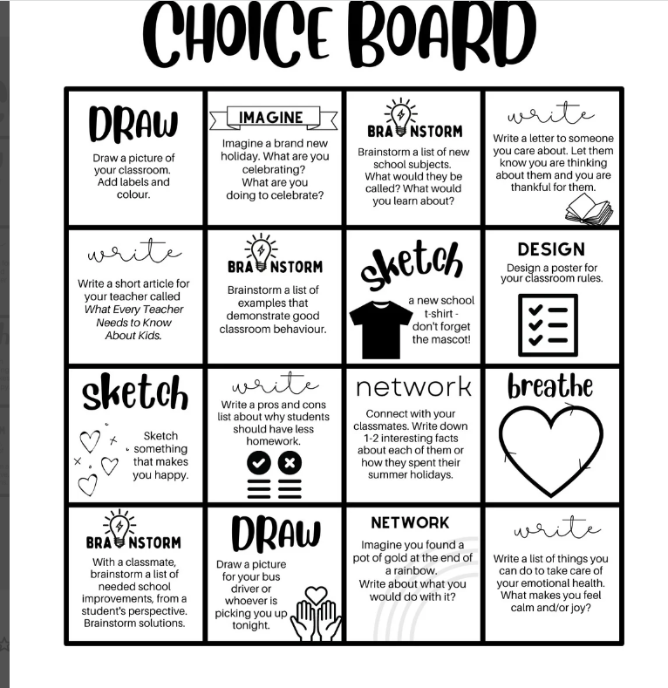
Variety is the key!

